Slide 1

Dive Against Debris®
Survey Lesson Guides
A Survey of Underwater Marine Debris
For Scuba Divers
This work is licensed under the Creative Commons Attribution-NonCommercial-NoDerivs 3.0 Unported License.
To view a copy of this license, visit http://creativecommons.org/licenses/by-nc-nd/3.0/
09/2015 Version 2.4

Slide 2
We’ll talk about . . .
SECTION 1: The Messy Problem of Marine Debris
The marine debris problem and how divers can help fix the mess
The Damage Done
What is This Marine Debris Stuff?
Where Does it Come From?
Can We Fix This Mess?
Dive Against Debris® - Dive For Change
Created Just For Divers
SECTION 1
Marine Debris
Welcome
Notes:
In Section 1, we look at the damage caused by marine debris and how divers can help fix this mess.

Slide 3
We’ll talk about . . .
SECTION 2: Time to Dive Against Debris®
Plan your dive – dive your plan
Long-term Surveys Give the Best Results
Choose Your Survey Site
Survey Dive Profiles
Gear
Take Pictures to Tell the Story
Things to Leave Behind
SECTION 2
Dive Time
Welcome
Notes:
In Section 2, we learn how to plan and complete a Dive Against Debris® survey.

Slide 4
We’ll talk about . . .
SECTION 3: Make Your Survey Count
Reporting your data
Step 1: Weigh
Step 2: Sort
Step 3: Record
Step 4: Dispose
Step 5: Report
SECTION 3
Report Data
Welcome
Notes:
In Section 3, we examine how to report your data.

Slide 5
We’ll talk about . . .
SECTION 4: Now It’s Your Turn!
Join AWARE divers around the world tackling marine debris
Some Final Dive Against Debris® Thoughts
Join the Project AWARE Movement
SECTION 4
Your Turn!
Welcome
Notes:
In Section 4, we find out how to join the global movement of Project AWARE divers protecting our ocean planet.

Slide 6
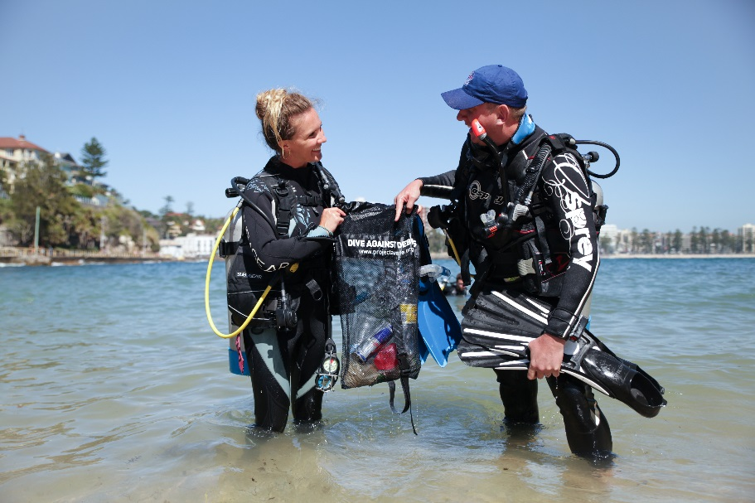
The Messy Problem of
Marine Debris
SECTION 1:
Notes:
In this section we look at the damage caused by marine debris and how divers can help fix this mess.

Slide 7
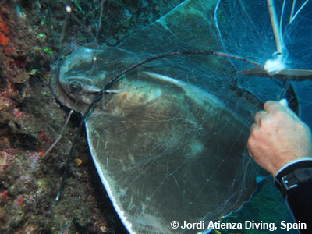
Marine Debris - The Damage Done
Kills Wildlife
Tens of thousands of marine animals and seabirds die every year
693 marine species affected
  All known sea turtle species
  Over half of all marine mammal species
  Almost two-thirds of all seabird species
Deaths due, mostly, to eating and entanglement
S1: Marine Debris
Notes:
Every year tens of thousands of marine animals and seabirds die from eating or getting tangled up in marine debris. Research has shown that marine debris affects 693 marine species. All known sea turtle species, over half marine mammal species and almost two thirds of all seabird species have ingested or become entangled in marine debris.
Many wildlife deaths happen when animals and seabirds eat marine debris. A piece of marine debris can choke an animal if it catches in their throat. Once swallowed many marine debris items, especially plastics, cannot be digested. A stomach full of plastic makes the animal feel like it no longer needs to feed and can lead to starvation.
In some species of sea turtles, fish, seabirds, mussels and marine mammals almost all individuals have plastics in their stomachs.
It’s hard to research the full impact on marine life, but one study of northern fulmar seabirds found dead on beaches showed 95 percent had plastic in their stomachs. Each bird had swallowed an average of 35 plastic pieces.

Slide 8
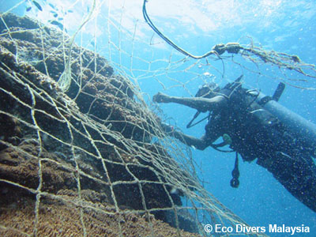
Marine Debris - The Damage Done
Damages Environments
Large items rub against reefs
Plastic bags smother seagrass and mangroves
Fishing nets and line cut into corals, sponges and anemones
Direct human impacts
Ugly to see
Unhealthy
Costly to remove
Only divers have the skills to remove and report underwater marine debris
S1: Marine Debris
Notes:
Marine debris damages marine environments causing further impact on the animals that live there. Large debris items rub against reefs moved by even a gentle swell, causing great damage. Plastics sheets and bags smother seagrass beds and mangroves, while fishing nets and fishing line wrap around reefs cutting into corals, sponges and anemones.
Marine debris also has a direct impact on human health and the economy. Polluted beaches are unattractive to visit and present a health risk if broken glass or personal hygiene items are present. Coastal councils that remove trash from beaches pass the expense of cleanup operations on to the local community, even though the debris may have moved there from sources outside the council area.
Marine debris damages recreational and commercial vessels, which sometimes require expensive repairs or the attendance of rescue services.
We often see marine debris washed up on beaches, but as much as 70 percent sinks to the seafloor. The need to address the marine debris issue is urgent.

Slide 9
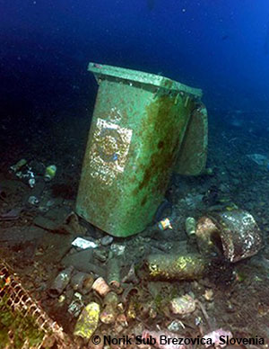
What is This Marine Debris Stuff?
Our waste in the ocean
  Everyday litter like plastic bags, food wrappers, drink bottles, cigarette butts
  Car batteries, kitchen appliances, fishing nets, industrial waste and more
Mostly not biodegradable
  Plastics break into small pieces
The waste products of our growing population are choking our ocean planet
S1: Marine Debris
Notes:
Marine debris is our waste in the ocean. From everyday litter like plastic bags, food wrappers, drink bottles and cigarette butts, to car batteries, kitchen appliances, enormous fishing nets and industrial waste, the trash we allow in the ocean is turning our beautiful reefs, beaches and seagrass meadows into rubbish dumps.
Many of our waste products, including plastics, do not biodegrade - instead they break down into smaller pieces that remain a danger to marine life as they are easily mistaken for food.

Slide 10
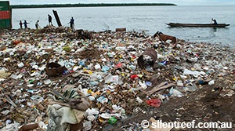

Where Does It Come From?
Humans are the source of all marine debris
Most comes from the land
But also lost or dumped at sea
town dumps next to the sea
untreated sewage
building & industrial waste
and more
boats and ships
oil and gas rigs
aquaculture farms
Ocean this way
S1: Marine Debris
Notes:
Rubbish moves to the ocean from both land and sea, but most of the debris in our ocean comes from land based sources. Regardless of where it comes from, humans are the source of all marine debris - either through accident, carelessness or purposeful dumping.
Rubbish enters the ocean due to lack of or poor waste management. Town dumps located next to the sea, untreated sewage discharging directly into the ocean, and poorly managed building or industrial waste all contribute to the marine debris problem.
Although most marine debris starts its journey on land, debris is also lost or purposefully dumped at sea - from boats and ships, oil and gas rigs, and aquaculture farms.

Slide 11
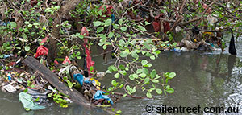
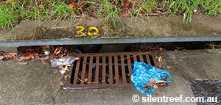
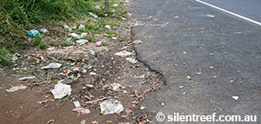
Where Does It Come From?
Public littering is also a major problem...
... streams and rivers,
or blown by the wind
...washed into drains...
Litter...
Ocean this way
S1: Marine Debris
Notes:
Public littering is also a major problem. Rubbish dropped even thousands of kilometres/miles inland will move to the ocean, washed into storm water drains and streams by the rain, or blown by the wind. We often shorten the journey by leaving our trash on a beach or next to a river.

Slide 12
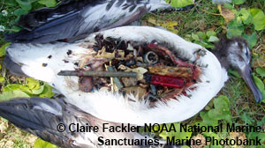
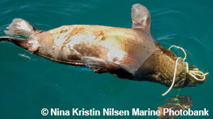
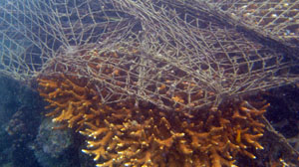
Where Does It Come From?
Mistake it for food
Once in the ocean marine debris
kills tens of thousands of marine animals and seabirds every year
Wraps around fins, flippers, wings and throats
Damages environments
S1: Marine Debris
Notes:
Once in the ocean it causes the death of tens of thousands of marine animals and seabirds every year who mistake it for food or get it caught around their bodies. It also damages environments such as coral reefs.

Slide 13
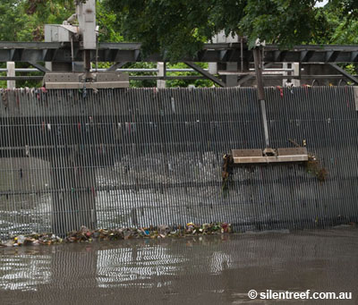
Can We Fix This Mess?
Yes We Can!
Work together locally, nationally and internationally on the many changes needed:
  Policies to manage
  Infrastructure to block
  Regulations to control
  Behaviours to reduce
S1: Marine Debris
Notes:
The marine debris problem seems so big – can divers really make a difference?
Yes we can, by working together locally, nationally and internationally on the many changes needed to fix this mess:
Changes in policies that make individuals, businesses and governments better manage waste
Changes in infrastructure to physically block trash before it reaches the ocean
Changes in regulations to better manage the things we make and how we make them - from manufacturing, to use, recycling and disposal
Changes in attitudes and behaviours so we can rethink, reduce, reuse, and recycle our way out of this mess

Slide 14
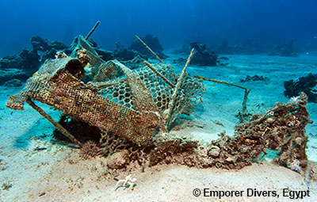
Dive Against Debris®
- Dive For Change
When you Dive Against Debris® you are diving for change
You make the ocean safer for marine life
The data you collect:
  Supports action on marine debris
  Illustrates the type and amount of rubbish
  Builds knowledge of impacts
You support local Project AWARE leaders
You convince others to change
S1: Marine Debris
Notes:
When you Dive Against Debris® you are diving for change, here’s how:
You make the ocean safer for marine life
The marine debris you remove can no longer hurt marine animals or damage marine environments
The data you collect:
Improves waste management by helping convince individuals, governments and businesses to act on marine debris
Expands our understanding of the types and amounts of rubbish in our ocean
Builds knowledge of the impacts on underwater environments caused by marine debris
You support Project AWARE leaders working in their community
Project AWARE leaders are working in their communities on changes that prevent rubbish from entering the ocean
Contact Project AWARE if you are keen to lead marine debris actions in your community
You convince others of the need to change
Tell everyone about your Dive Against Debris® actions and the rubbish you see underwater
Your voice can change public opinion so people demand action on marine debris
You can help change people’s behaviour so less trash is dumped in the environment

Slide 15
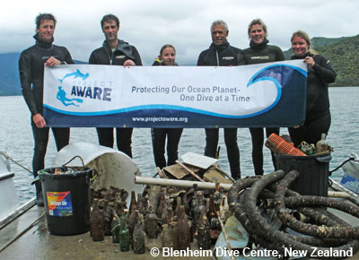
Created Just For Divers
Only divers have the training, knowledge and skills to remove marine debris from underwater
70% of rubbish entering the ocean sinks to the seafloor
The problem is big but the Project AWARE‘s global movement of divers is strong
Together our actions make a difference
Don’t Let Your Dives
Go to Waste!
S1: Marine Debris
Notes:
Dive Against Debris® was created by divers, for divers. Only divers have the training, knowledge and skills to remove marine debris from underwater.
It is estimated as much as 70 percent of the rubbish entering our ocean sinks to the seafloor, and although much of this is likely to be outside the reach of recreational divers, we still have the power to tackle underwater marine debris head on.
The marine debris problem is big, but the Project AWARE’s global force of divers is strong. Through Dive Against Debris® divers are playing a major role in keeping our ocean clean and healthy.

Slide 16
We’ve talked about
SECTION 1: The Messy Problem of Marine Debris
The marine debris problem and how divers can help fix the mess
The Damage Done
What is This Marine Debris Stuff?
Where Does it Come From?
Can We Fix This Mess?
Dive Against Debris® - Dive For Change
Created Just For Divers
Any Questions?
S1: Marine Debris

Slide 17
Time to
Dive Against Debris®
SECTION 2:
Notes:
In Section 2, we learn how to plan and complete a Dive Against Debris® survey.

Slide 18
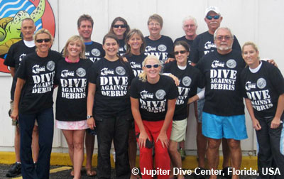
Plan Your Dive
Repeat surveys at the same location give the best results
Build an argument for change
Help identify seasonal trends
  Weather patterns
  Tourist seasons
How often should we survey?
  No requirement, but
    Monthly - best
    Every other month - good
    Once per season - minimum
Plan Your Dive
S2: Dive Time
Notes:
Your surveys will have more value if you repeatedly collect data from the same site over a period of time. Regular surveys will:
Build a more convincing argument for change
Help identify local seasonal trends, such as those caused by weather patterns or tourist seasons
There are no requirements for how often you should repeat your survey, all data on underwater marine debris is of value. However to maximise your results consider monthly surveys at the same location, or one survey every two months. As a minimum try to hold a survey at the same time and the same location for each season of the year.
Of course if you find marine debris during any dive you can remove and report it through Dive Against Debris®. It only takes a few seconds to help the marine environment.

Slide 19
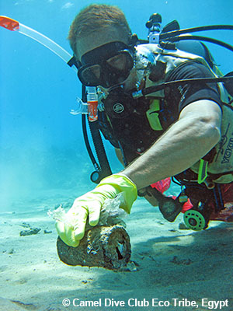
Choose Your Survey Site
Use these considerations to choose your survey site:
Can return regularly
Within dive skills and experience of all participants
Survey fresh water lakes and rivers
Permission required?
Underwater or a Land Cleanup?
Only report marine debris found by divers underwater through
Dive Against Debris®
Plan Your Dive
S2: Dive Time
Notes:
Use these considerations when choosing your survey site:
Choose a site you can return to regularly
Your surveys will have more value if you collect data from the same site over a period of time
Choose a site within the dive skills and experience of all participants
Survey fresh water lakes and rivers
Dive Against Debris® surveys are equally important in fresh water environments
If necessary gain permission to dive and remove marine debris from the landowner or other authorities
This includes Dive Against Debris® surveys inside marine protected areas such as marine parks where local regulations may prohibit marine debris removal
Underwater or a Land Cleanup?
Marine debris is everywhere; underwater, on the beach, in the shallows and, caught up in mangroves. So how do you know what data you should report through Dive Against Debris®? The easy answer is if you need to be on SCUBA to collect your marine debris you can report it through Dive Against Debris®.

Slide 20
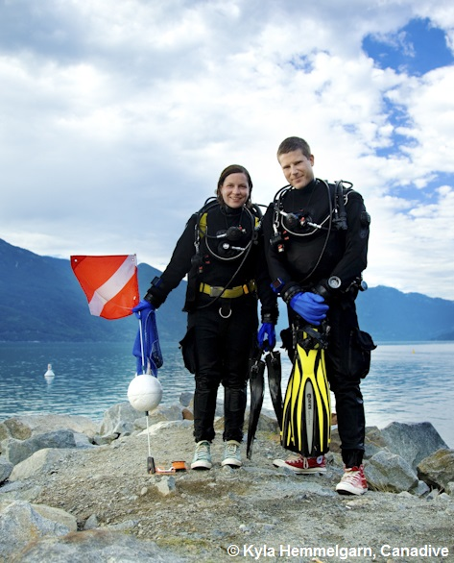
Survey Dive Profiles
Consider the experience levels of all divers
Safety is your primary consideration
Bottom time and depth
  Set safe dive profiles
Buoyancy
  Properly weighted
  Gear streamlined and secured
Survey Area
  No set area
  Try to cover the same area each time you survey your site
Number of participants
Buddy team strategies
Plan Your Dive
S2: Dive Time
Notes:
Plan your Dive Against Debris® survey to be safe and fun taking consideration of the experience levels of all divers.
Safety is your primary consideration
Follow all normal safe diving practices
Dive within your and your buddy’s skills and experience
Consider a safety diver - either on the boat or on shore
Bottom time and depth
Set your own bottom time and depth depending on local conditions and diver experience
Remain well within the no-decompression limits of your dive table or dive computer
Buoyancy
Check that you and your buddy are properly weighted to maintain neutral buoyancy throughout your dive
Assure all your gear is streamlined and secured
Survey Area
No set area to be surveyed but try to cover the same area each time you survey your site
Consider dive flags to mark your area (follow local protocols on dive flag use)
Number of Participants
No limits on the number of divers
All divers to work in buddy teams
Report all divers’ findings from the same survey dive on one Data Card
Buddy team strategies
All divers in a buddy team are responsible for monitoring the dive
Review communications and buddy separation procedures before the dive
Discuss dive roles, for example:
Buddy 1: carries the mesh bag
Buddy 2: removes items / takes photographs

Slide 21
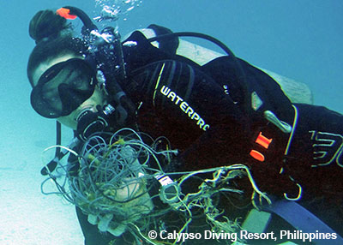
Dive Your Plan
During your dive, collect marine debris you encounter – when back on land, sort and record what you removed from the seafloor only
Work with your buddy
Do not use your BCD as a lifting device
Do not overfill your mesh bag
Items weighing more than 4kg/7lb should only be removed by divers trained in the use of lift bags
Do not use lift bags without training/experience
Dive Your Plan
S2: Dive Time
Notes:
During your dive, collect the marine debris you encounter - when back on land, sort and record what you removed from the seafloor only.
Work with your buddy to place marine debris in your mesh bag
Do not use your BCD as a lifting device for heavy items
Do not overfill your mesh bag and do not carry more than 4kg/7lb without a lift bag. Items weighing more than 4kg/7lb should only be removed by divers trained in the use of lift bags such as those certified as PADI Search and Recovery Specialists
Do not use lift bags without training/experience. Removing heavy objects requires proper training and use of lift bags

Slide 22
Gear
The right gear will help make your dive safe and enjoyable
Required:
  Mesh bags
  Dive tool/knife
  Gloves
Recommended:
  Scissors
  GPS
  Weighing scales
  Underwater camera
  Sharps container
  Blank slate and pencil
Dive Your Plan
S2: Dive Time
Notes:
The right gear will help make your dive safe and enjoyable.
Required Gear
Mesh bags for marine debris collection
Mesh to let the water flow out
Dive tool/knife
Gloves for hand protection
Check that use of gloves is permitted at your survey location
Kitchen or garden gloves are ok to use if you do not have dive gloves
Recommended Gear
Scissors
GPS
Weighing scales
Underwater camera
Sharps container
Blank slate and pencil

Slide 23
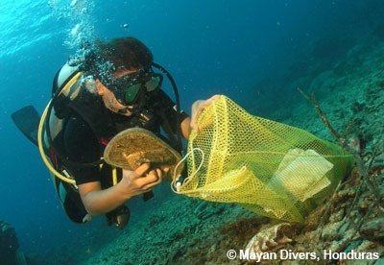
Buoyancy Objects
Pay attention to your buoyancy and trim
Keep your
  gear
  body
  and fins
    off the bottom
Remain aware of your body’s
positioning throughout your dive
Dive Your Plan
S2: Dive Time
Notes:
It’s particularly important to pay attention to your buoyancy and trim during Dive Against Debris® survey. Keep your gear and your body, remembering your fins, away from the bottom. Most importantly, remain aware of, and correct as needed, your body’s positioning as you remove debris and put it in your mesh bag.

Slide 24
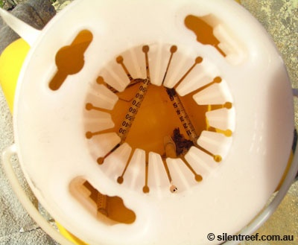
Sharp Objects
Take care with objects that can cause a puncture wound
Do not remove if unsafe
Use a strong container
Use extra caution when removing medical sharps:
  syringes, needles, scalpels, lancets, suture needles
Dive Your Plan
S2: Dive Time
Notes:
Take care with objects that can cause a puncture wound such as syringes, broken bottles and metal cans
Before removing carefully consider the safety of all participants
Use a strong container with a secure lid to safely remove sharp objects
Be very careful when choosing to remove medical sharps - includes syringes, needles, scalpels, lancets and suture needles

Slide 25
Take Pictures to Tell the Story
Photos are not required but they illustrate the problem and convince others to act
Two types of photos to take:
1. Photos to explain your data:
  Marine debris damaging the environment
  Entangled animals
  Items you cannot identify
  Marine debris underwater
  Items you did not remove
Share these photos when you submit your data
2. Photos that tell your story:
  Group shots
  Divers in action
  Divers counting and recording debris
  Surface shot of the rubbish you removed
Use for your blog on My Ocean
Consider sharing via Facebook® or ScubaEarth®
Use them to illustrate a story in your local paper
Dive Your Plan
S2: Dive Time
Notes:
Taking photos is not a survey requirement, but photos are great for convincing non-divers and decision makers that marine debris is a real problem. Your photos can illustrate impacts to marine wildlife and environments and help build a library of images that show people the scale of the problem.
There are two types of photos to take:
1. Photos that help explain your data:
These photos help us understand the debris you saw. Attach this type of photo when you submit your data. If possible, provide a reference for scale such as a ruler or snorkel. Examples of this type of photo are:
Marine debris damaging the environment
Entangled animals
Items you cannot identify
Marine debris underwater
Items you did not remove
2. Photos that tell your story:
Use this type of photo to raise publicity about your actions, thank participants and recruit volunteers. Upload these photos to your My Ocean blog about your survey (see page 23), share them on Facebook or use them to illustrate a story in your local paper.
Group shots - all your buddies together with the trash you removed
Divers in action
Divers counting and recording debris
A surface shot of all the rubbish you removed
Tips for taking photos:
Do not spend long taking photos to avoid altering the meaning of your Survey Duration
Follow AWARE’s 10 Tips for Divers to Protect the Ocean Planet

Slide 26
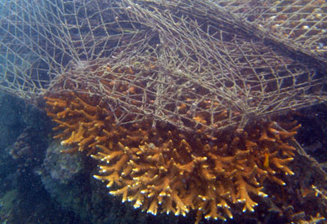
Things to Leave Behind
Marine life soon grows on, or lives in, marine debris – should we remove these items?
SAFETY FIRST
Is item harmless?
  Perhaps leave in place
Could item cause harm?
  Perhaps worth small short-term disturbance to remove
If unsure
leave it in place
S2: Dive Time
Notes:
Marine life soon grows on marine debris and marine animals often make a home in pieces of marine debris. In these cases, you should decide whether to remove an item or leave it in place. Sometimes it is worth a small short-term disturbance to remove potentially harmful marine debris, other times it may be better to leave the item in the ocean. Following are some points to consider when deciding to remove a marine debris item:
If you are unsure, leave it in place
Safety is Your Primary Consideration
If you are unsure if it is safe to remove an item leave it in place
Do not touch or remove weapons or ammunition - mark the location and inform the authorities
Take great care with or leave in place items that may leak chemicals that could be harmful if they come in contact with your skin or equipment

Slide 27
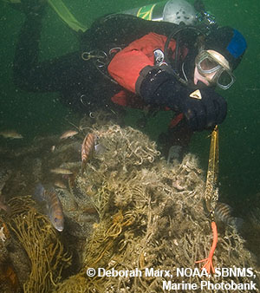
Things to Leave Behind
Consider these points when deciding to remove a debris item:
Material of construction?
  Glass bottles & steel cans
    perhaps leave
  Hard plastics, fish traps, packaging material, etc
    perhaps remove
Contents of Item?
  Batteries, fuel containers, paint cans etc
    remove if safe to do so
Fishing nets, line and rope
  Selective removal?
    scissors work well
S2: Dive Time
Notes:
Material of Construction
Items such as glass bottles and steel cans do not cause much harm to the environment so leave them in place if removal will disturb marine life
Consider removing non-natural items that could harm marine animals as they break down into smaller pieces, even if doing so will cause a short-term disturbance. In these cases use your judgement of what action will cause the least harm. Items in this category include hard plastics, fish traps and packaging material
If eggs are attached to a marine debris item, mark the location and return to remove it once the eggs have hatched
Contents of the Item
If an item contains chemicals that may leak and cause harm, it should be removed if safe to do so:
Examples include car, truck and boat batteries; oil, fuel and chemical containers; paint cans; fuel filters and; electronic equipment
If it is not safe to remove a potentially hazardous item you could mark its location and report it
Fishing Nets, Fishing Line and Rope
Removing fishing nets, fishing line and rope can be dangerous
Do not attempt to remove these items unless you are sure it is safe
Removing these items can be difficult, especially if they are wrapped around corals, or have corals growing over them
The best approach may be to selectively remove accessible parts and leave the sections that have become overgrown
Strong, sharp scissors cut through fishing line and light nets with less disturbance than a dive knife as they do not require a sawing motion

Slide 28
We’ve talked about
SECTION 2: Time to Dive Against Debris®
Plan your dive – dive your plan
Long-term Surveys Give the Best Results
Choose Your Survey Site
Survey Dive Profiles
Gear
Take Pictures to Tell the Story
Things to Leave Behind
Any Questions?
S2: Dive Time

Slide 29
Make Your
Survey Count
SECTION 3:
Notes:
In Section 3, we examine how to report your data.

Slide 30
5 Easy Steps to Make Your
Survey Count
Sorting and recording debris is quick when everyone works together, follow these 5 easy steps:
3. Record
2. Sort
4. Dispose
1. Weigh
5. Report
S3: Report Data
Notes:
NOTE TO PRESENTER: Provide participants with a copy of the Dive Against Debris® Data Card to help them follow this section.

Slide 31

Step 1: Weigh
Weigh debris while still in the mesh bags:
Subtract weight of empty bags if significant
Can use fishing or kitchen scales
Estimate if no scales
Record in kilograms or pounds
Step 1: Weigh
S3: Report Data
Notes:
Weigh all your marine debris while still in the mesh bags. If the weight of the mesh bags is significant, weigh them separately once they are empty and subtract their weight to arrive at the true weight of your debris.
Fishing or kitchen scales work well for weighing debris
You can estimate weight if you do not have scales
Record weight in kilograms or pounds

Slide 32
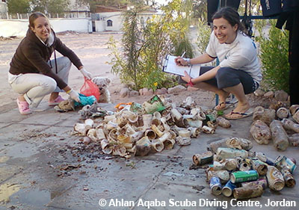
Step 2: Sort
Empty mesh bags and sort debris into piles under the 9 material of construction categories:
Plastic
Glass & Ceramic
Metal
Rubber
Wood
Cloth
Paper/Cardboard
Mixed Materials
Other
Step 2: Sort
S3: Report Data
Notes:
To make it easy to find debris items on the Dive Against Debris® Data Card they have been grouped by material of construction. Empty your mesh bags and sort your debris into piles under the nine categories:
Plastic
Glass & Ceramic
Metal
Rubber
Wood
Cloth
Paper/Cardboard
Mixed Materials
Other Debris Items, any item that cannot be placed in another category
Sort your debris out of the wind to avoid rubbish being blown back into the water. Emptying your mesh bags onto a tarpaulin will help keep your debris items together.

Slide 33
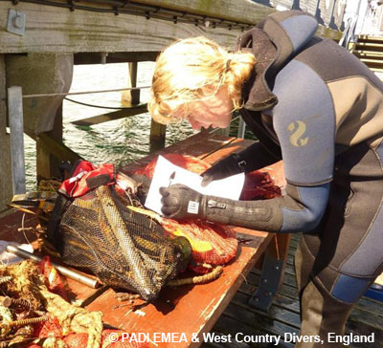
Step 3: Record
Work through each pile to record every item onto the Dive Against Debris® Data Card
Record each debris item as 1
Count miscellaneous pieces as “fragments”
Combine all diver’s findings from the same survey dive on one Data Card
Step 3: Record
S3: Report Data
Notes:
Work through each pile to record every item you found onto the Dive Against Debris® Data Card. Use the Marine Debris Identification Guide to help correctly identify debris items.
Each debris item counts as one, regardless of size
Look for your debris item under the material of construction categories, for example:
If you find a plastic fork look under the Plastic Materials category to find cups, plates, forks, knives, spoons
Mark this box as I
If you find a second plastic fork or another item in this category mark this box as II
Continue using a tally system that works for you, for example: IIII IIII II = 12
Miscellaneous pieces of marine debris should be counted as fragments - see the end of each material category on the data card
To count many small pieces (2.5 mm and smaller) see the Too Small to Count box on the next slide
Combine all diver’s findings from the same survey dive on one Data Card
One buddy pair on your survey dive or ten buddy pairs - record all debris items on one Data Card

Slide 34
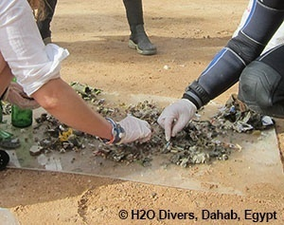
Step 3: Record
Too Small to Count?
Here’s a quick way to count many small pieces:
  Sort into similar sized piles
  Count pieces in one pile
  Multiply by number of piles
Record as “fragments”
Step 3: Record
S3: Report Data
Notes:
Sometimes you may remove a large amount of similar small pieces of debris, for example a mound of plastic pellets dumped in the ocean or a hard plastic item that has disintegrated into many small pieces. In these cases, there may be too many pieces to count, so how do you record this find?
The method for many small pieces (mostly smaller than 2.5cm/1in) is to place them on a tarpaulin out of the wind and sort them into roughly equal sized piles. Then count the number of pieces in one of your piles and multiply this by the number of piles to reach the total. Record these small pieces as “fragments” under the relevant material of construction.

Slide 35
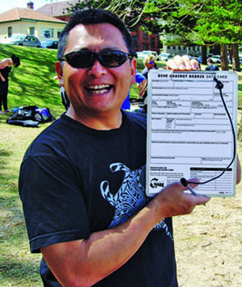
Step 3: Record
When reporting data online you will be asked the following about your survey site:
Survey Site Location
  City/Town
  State/Province
  Country
Survey Site GPS Coordinates
  Accuracy matters
  Use the point-and-click map on the online Data Submission Form, OR
  Take GPS readings:
    WGS84 / Decimal Degrees
Step 3: Record
S3: Report Data
Notes:
Complete the remainder of the Data Card to record important information about your survey.
Survey Site Location
Information to help us verify that your survey site is accurately positioned on the map:
Nearest road name (if applicable)
City/Town
State/Province
Country
Survey Site GPS Coordinates
Accurate GPS information is essential to reporting your data. It puts your data in a geographical context and helps make sure your survey shows up correctly on Project AWARE’s Dive Against Debris® Map.
You can report your Survey Site GPS Coordinates without a GPS unit by using the point-and-click map found on the Dive Against Debris® online Data Submission Form:
Drag the map to find your country
Zoom in on your location
Locate your survey (dive) site and click on the map
Your Survey Site GPS Coordinates are automatically recorded
Works best for Survey Sites with adjacent landmarks
To use a GPS unit, for example if your Survey Site is not close to land and so would be hard to accurately locate using the point-and-click map, note the following:
Set your GPS unit to:
WGS84 Map Datum
Take readings in decimal degrees
Boat dives:
Take your GPS reading while the boat is moored at, or floating directly over, the Survey Site (look out for divers in the water)
Shore dives:
Take your reading standing on the foreshore as close to the Survey Site as possible

Slide 36
Step 3: Record
Take care to properly record your Survey Duration:
Average time spent by all buddy teams while underwater removing marine debris
Record in minutes
  i.e. 45 minutes, 115 minutes
Do not include time for
  Surface swims
  Ascents/descents
  Non-dive participants
  Sorting and recording debris
Step 3: Record
S3: Report Data
Notes:
Take care to properly record your Survey Duration as incorrect entries will devalue your findings.
Survey Duration is the average time spent by all buddy teams while underwater removing marine debris
Record Survey Duration in minutes i.e. 45 minutes, 115 minutes
Do not include time for surface swims and ascents/descents
Do not include time for non-dive participants or for sorting and recording your debris

Slide 37
Step 3: Record
Calculating Survey Duration Examples
Example 1
1 buddy team of 2 divers
Remove underwater marine debris for:
43 mins
No other divers on the survey
Survey Duration = 43 minutes
Example 2
  3 buddy teams
    Team A & B = 2 divers each
    Team C = 3 divers
Remove underwater marine debris for:
Buddy Team A: 42 mins
Buddy Team B: 48 mins
Buddy Team C: 51 mins
Combined survey time = 141 mins
141 minutes / 3 buddy teams = 47 mins
Survey Duration = 47 minutes
Step 3: Record
S3: Report Data
Notes:
Calculating your Survey Duration
Example 1.
You and your buddy work together to remove underwater marine debris for 43 minutes. There are no other divers on your survey.
Survey Duration = 43 minutes
Example 2.
Three buddy teams with two divers in Team A and B and three divers in Team C remove underwater marine debris for the following durations:
Buddy Team A: 42 minutes
Buddy Team B: 48 minutes
Buddy Team C: 51 minutes
Combined survey time = 141 minutes
141 minutes combined survey time / 3 buddy teams = 47 minutes
Survey Duration = 47 minutes

Slide 38
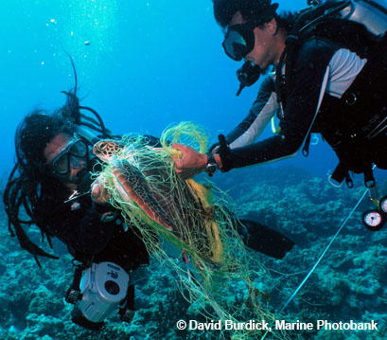
Step 3: Record
More information on your survey
Number of Participants
  Only count divers collecting rubbish underwater
  Count individual divers
  Do not include non-divers
Wave Conditions
  Calm, Smooth, Slight or Moderate to rough
  See the Survey Guide or Data Card for more details
Step 3: Record
S3: Report Data
Notes:
Number of Participants
Only count divers collecting rubbish underwater.
Count individual divers, not buddy teams
Do not include surface only participants for example a safety diver or friends that complete a beach cleanup while you are diving
Wave Conditions
Report wave conditions as follows:
Calm (glassy to rippled) for waves 0 – 0.1 metres/0 - 4 inches high
Smooth (wavelets) for waves 0.1 - 0.5 metres/4 - 19 inches high
Slight for waves 0.5 - 1.25 metres/19 inches - 4 feet high
Moderate to rough for waves greater than 1.25 metres/4 feet

Slide 39
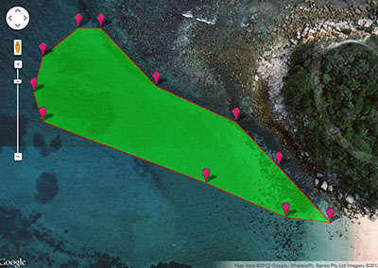
Step 3: Record
More information on your survey
Report the area you surveyed to help understand the density of rubbish at your site:
Easy and accurate online tool
Square metres or square feet
Cannot use the online tool?
  Calculate area by multiplying length by breadth
  Estimate if no other option available
Use an online tool to measure area
Step 3: Record
S3: Report Data
Notes:
Area Surveyed
This information helps build an understanding of the density of debris at your site.
An easy and accurate way to measure area is to use a point-and-click tool over a Google Map such as the one found here:
www.daftlogic.com/projects-google-maps-area-calculator-tool.htm
Report area in square meters or square feet
If you cannot use the online tool, remember the following when calculating Survey Site area:
For simple square or rectangle shapes calculate area by multiplying length by breadth
Make an estimate if it is not possible to measure or you cannot use the tool above

Slide 40
Step 3: Record
More information on your survey
Dominant Substrate
  Seafloor type over which most of your survey took place
Sand
Silt
Gravel
Rock
Coral
Seagrass
Other (please describe)
Ecosystem
  Environment in which your survey took place
Coral reef
Rocky reef
Kelp
Mangroves
Seagrass
Other (please describe)
Step 3: Record
S3: Report Data
Notes:
The difference between Dominant Substrate and Ecosystem
You survey a coral reef and spend most of your Survey Duration swimming over the sand between coral heads:
Dominant Substrate = Sand
Ecosystem = Coral reef
You survey a coral reef and spend most of your Survey Duration swimming over the coral:
Dominant Substrate = Coral
Ecosystem = Coral reef.

Slide 41
Step 3: Record
More information on your survey
Entangled Animals
  Record species and type of marine debris
  Take photos and submit with your data
Survey Depth Range
  Max and min depths from which you removed debris
  May be less deep than the max depth of your dive
  Do not report 0 for min depth
    Floating debris should not be reported
Step 3: Record
S3: Report Data
Notes:
Entangled Animals
Report entangled animals and the type of marine debris involved. If possible, identify the species name; if unknown use a common name i.e. “seal”. Take photos of entangled animals to upload when reporting your data.
Survey Depth Range
Report the maximum and minimum depths from which you removed debris.
May be less deep than the maximum depth for your dive
Do not report 0 metres or feet for your minimum depth
Floating debris can be removed but should not be reported

Slide 42
Step 3: Record
More information on your survey
Weather Conditions for Previous Week
  Weather events that may have moved debris onto or away from your site
Items of Local Concern
  Your top 3 problem debris items and why
Additional Information
  Events that could have contributed to the debris found
Step 3: Record
S3: Report Data
Notes:
Weather Conditions for Previous Week
Report strong winds, storms, heavy rain or any weather event that may have moved debris onto or away from your site.
Items of Local Concern
List the top three debris items you consider a problem in your location and tell us why.
Most Unusual Item Found
Additional Information
Briefly describe events that could have contributed to the debris found, provide link to news stories if available:
Hurricanes, building demolition, festivals or street celebrations, fireworks display, etc.

Slide 43
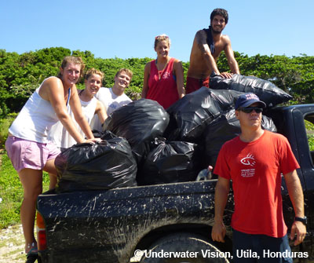
Step 4: Dispose
Dispose of your debris carefully so it cannot return to the ocean:
Sort for recycling
Small amounts in street bins
Local government authority may collect
Transport to a waste collection site
Know local laws governing disposal
  Check procedures for disposing hazardous items such as fluorescent light tubes, light sticks/cyalumes, fuel/oil containers, etc
Step 4: Dispose
S3: Report Data
Notes:
You removed it and counted it - great job! Now take a moment to dispose of it properly so it cannot return to the ocean.
Sort for recycling as available in your area
Small amounts can be placed in street bins
Some local government authorities will collect your rubbish
Make the arrangement before your survey
If leaving for collection by local authorities make sure bags are securely tied
Take it to the local waste collection site
Be familiar with local laws governing debris disposal. Many local government authorities have special procedures for disposing items that contain hazardous materials such as fluorescent light tubes, cyalume light sticks, and containers with oil, chemicals, fuel or paint. Contact your local authorities for advice on disposing these items.

Slide 44
Step 5: Report
Now report your data
English data submissions:
Use the online data submission form
Submit all English data using the online data submission form www.projectaware.org/DiveAgainstDebrisData
You will need a My Ocean profile
  Log in or create new
Follow instructions on the online form
Refer to the Dive Against Debris® Survey Guide for clarification
Non-English submissions:
Email your completed Data Card
For all data in languages other than English, please email your completed Dive Against Debris® Data Card and any photos to
diveagainstdebris@projectaware.org
Ensure that all fields are completed accurately
Step 5: Report
S3: Report Data
Notes:
Your Dive Against Debris® survey has led to this moment - reporting your data online.
All English data submissions must be made using the Online Data Submission Form.
English data must be reported through the Online Data Submission Form:
www.projectaware.org/DiveAgainstDebrisData
To use the form, first log in to your My Ocean profile, or create a new My Ocean profile
Follow instructions on the form and refer to this Survey Guide if you need clarification
Any non-English data submissions can be made by emailing a copy of the completed Data Card.
For non-English data, email a copy of your completed Dive Against Debris® Data Card to diveagainstdebris@projectaware.org, ensuring you have clearly filled in all data fields.

Slide 45
Step 5: Report
Before submitting data you will be asked to confirm the Dive Against Debris® Surveyor Statement:
I have read the Dive Against Debris® Survey Guide and the data I am reporting was collected underwater, during one dive and completed by single or multiple buddy teams. I understand I should only include data on trash collected from underwater environments here. Repeat dives should be reported through separate submissions and debris collected on land can be shared with the My Ocean community. I understand that the data I submit will be visualized on the Dive Against Debris® Map following a review and provided it satisfies Project AWARE’s internal quality review process.
Only divers have the skills to remove and report underwater marine debris
Step 5: Report
S3: Report Data
Notes:
Before submitting data you will be asked to confirm the Dive Against Debris® Surveyor Statement:
I have read the Dive Against Debris® Survey Guide and the data I am reporting was collected underwater, during one dive and completed by single or multiple buddy teams. I understand I should only include data on trash collected from underwater environments here. Repeat dives should be reported through separate submissions and debris collected on land can be shared with the My Ocean community. I understand that the data I submit will be visualized on the Dive Against Debris® Map following a review and provided it satisfies Project AWARE’s internal quality review process.

Slide 46
We’ve talked about
SECTION 3: Make Your Survey Count
Reporting your data
Step 1: Weigh
Step 2: Sort
Step 3: Record
Step 4: Dispose
Step 5: Report
Any Questions?
S3: Report Data

Slide 47
Now It’s
Your Turn!
SECTION 4:
Notes:
In Section 4, we find out how to join the global movement of Project AWARE divers protecting our ocean planet.

Slide 48
Some Final
Dive Against Debris® Thoughts
Start your regular Dive Against Debris® survey, then:
Share Your Actions to Help Change Behaviours
Project AWARE’s My Ocean www.projectaware.org/MyOcean
  Blog stories on your actions
  Upload photos and videos
  Seek participants to join events
  Find events to join
S4: Your Turn!
Notes:
Now you are ready to join AWARE divers around the world tackling marine debris - together we can fix this mess!
My Ocean (www.projectaware.org/MyOcean) is Project AWARE’s unique eco-networking site where AWARE leaders act for ocean protection. Create a My Ocean profile to report your Dive Against Debris® data, post blog stories on your ocean protection activities and Start an Action to seek participants for your Dive Against Debris® surveys.
Share Your Actions to help change behaviours that are polluting our ocean with rubbish:
Tell the story of your Dive Against Debris® survey on your My Ocean page
Gain media about your Dive Against Debris® survey so others learn about the marine debris problem

Slide 49
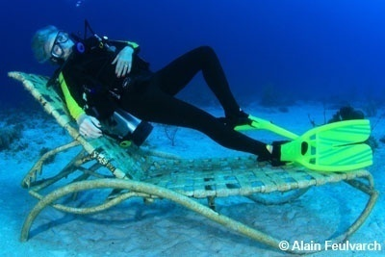
Some Final
Dive Against Debris® Thoughts
Report Clean Sites
Any Dive, Any Time
What About Land Cleanups?
  Only report debris found underwater by divers
Provide Feedback:
www.projectaware.org/contact
S4: Your Turn!
Notes:
Now you are ready to join AWARE divers around the world tackling marine debris - together we can fix this mess!
Report Clean Sites
Finding no debris on a dive is still important data to submit as it helps identify when new problems arise. Select the “Our Survey Site Was Free Of Debris” option when submitting your data
Dive Against Debris® - Any Dive, Any Time
Your data is of most use when collected regularly from the same survey site; however, you can report rubbish from any dive at any time through Dive Against Debris®.
What About the Land Cleanup Completed by our Friends?
It’s great to combine your underwater survey with a beach or foreshore cleanup but only report debris found by divers underwater through Dive Against Debris®. If your friends complete a land cleanup:
Keep the trash collected on land separate from the underwater debris
Only sort, record and report marine debris found underwater through Dive Against Debris®
Provide Feedback
Share your Dive Against Debris® experience with us
Send comments and suggestions to DiveAgainstDebris@projectaware.org

Slide 50
Join the Project AWARE Movement
Project AWARE divers protect our ocean planet - one dive at a time
Battle the Big Two:
Sharks and Rays in Peril
  Become an AWARE
  Shark Conservation Diver
Marine Debris
  Dive Against Debris®
Be an AWARE Diver
  Ten Tips for Divers to Protect the Ocean Planet
S4: Your Turn!
Notes:
Project AWARE Foundation is a global movement of scuba divers protecting the ocean planet - one dive at a time. Visit www.projectaware.org to find the latest calls to action, petitions and activities you can join to help protect our ocean planet.
Battle the Big Two
Project AWARE is focusing on two major ocean protection issues where scuba divers are uniquely positioned to affect long-term change:
1. Sharks and Rays in Peril
Many shark and ray populations are in trouble, mainly due to overfishing. Join ongoing campaigns with Project AWARE to help protect the world’s most vulnerable shark and ray species. Find out more about the issues and learn about your local sharks and actions you can take to help protect them by becoming an AWARE Shark Conservation Diver. Ask your PADI Dive Centre or Resort for details.
2. Marine Debris
Only divers have the skills to remove underwater marine debris. Underwater cleanups help, but to make a lasting change we must stop rubbish from reaching the ocean. Divers can help by reporting data on marine debris through Dive Against Debris®. You can shine a light on marine debris issues and help reduce its devastating impacts on marine life and marine environments.

Slide 51
We’ve talked about
SECTION 4: Now It’s Your Turn!
Join AWARE divers around the world tackling marine debris
Some Final Dive Against Debris® Thoughts
Join the Project AWARE Movement
Any Questions?
S4: Your Turn!

Slide 52
Thank you
Questions?

