Slide 1
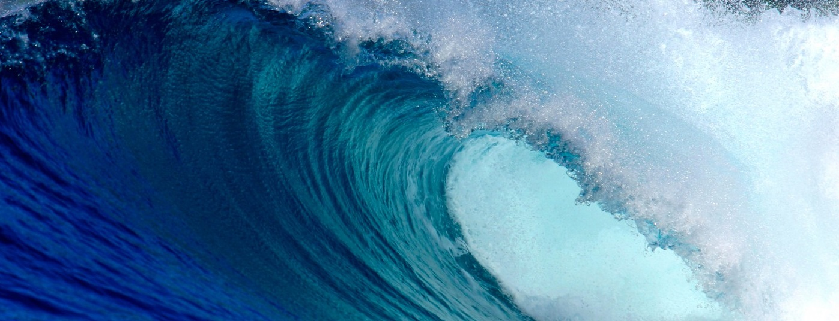
Project AWARE Specialty
Lesson Guides

Slide 2
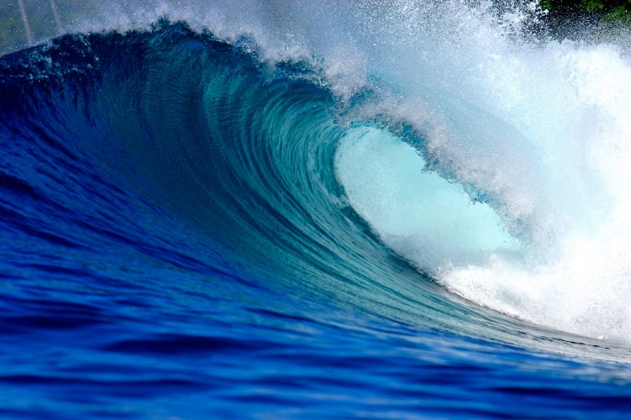
Overview
Introduction and Course Goals
Project AWARE and its Mission
10 Tips for Divers: From Awareness to Action >> Take Action Workshops
Knowledge Review
Stay Connected
Certification

Slide 3
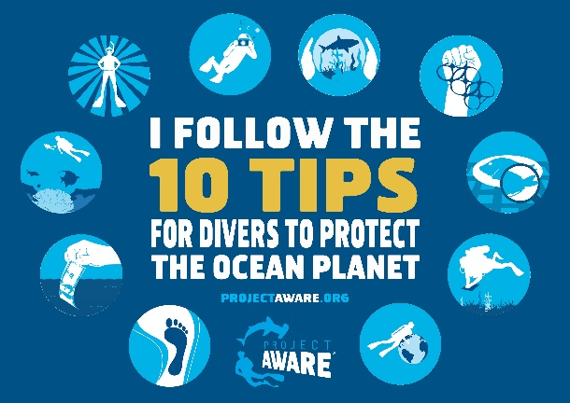
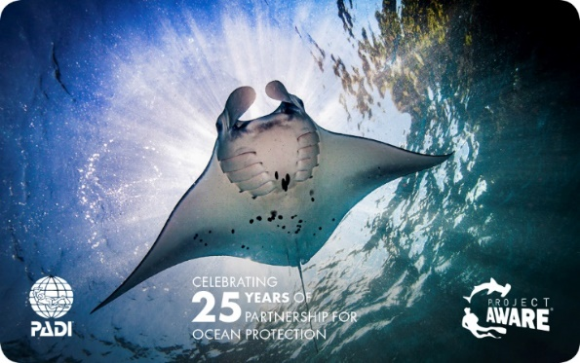
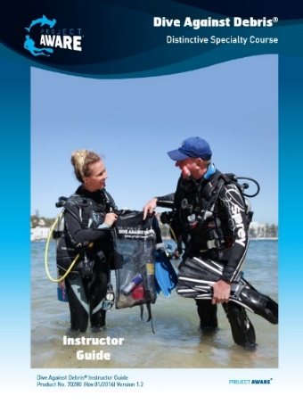
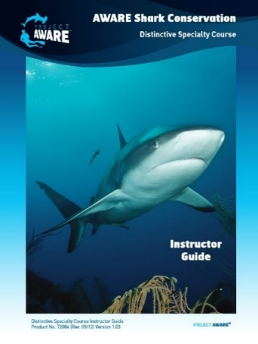
Introduction and Course Goals
Course Goal: The Project AWARE Specialty course focuses and expands on the ‘10 Tips for Divers to Protect the Ocean Planet’ to provide guidance and help you make a difference for ocean protection
Certification: Choose to donate for the Project AWARE version of your PADI certification card
Other Project AWARE courses: Also take the Dive Against Debris® or the AWARE Shark Conservation Specialty

Slide 4
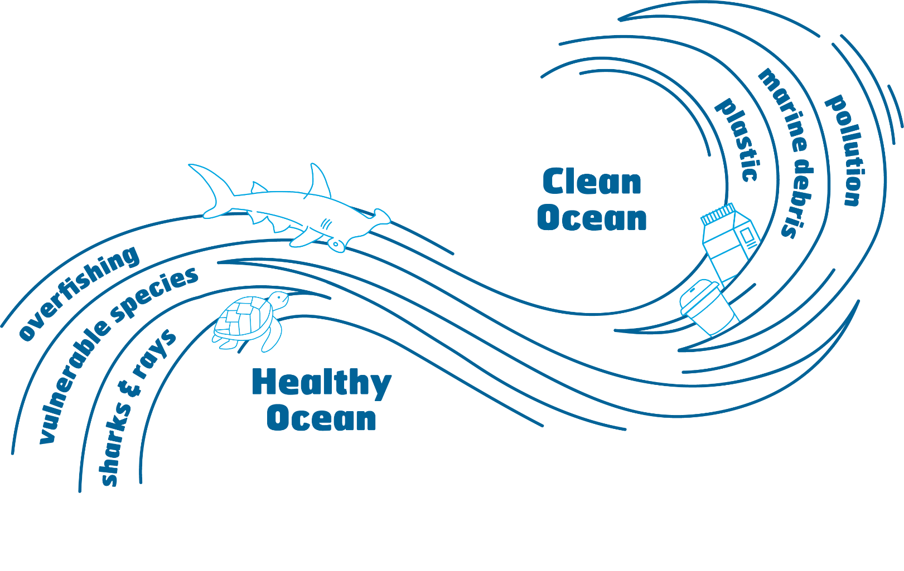
Project AWARE and Its Mission
Project AWARE is a registered nonprofit organization and global movement for ocean protection powered by a community of adventurers
Vision: a return to a clean, healthy ocean
Mission: Connect the passion for ocean adventure with the purpose of marine conservation to create lasting change for the ocean

Slide 5
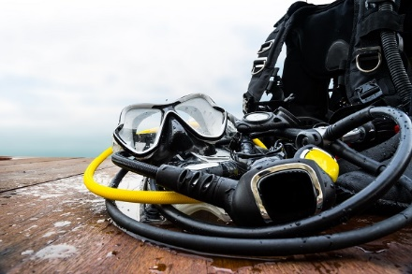
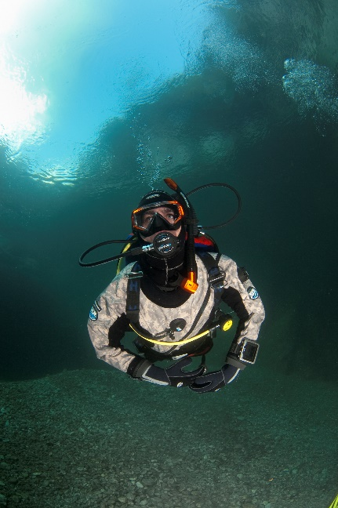
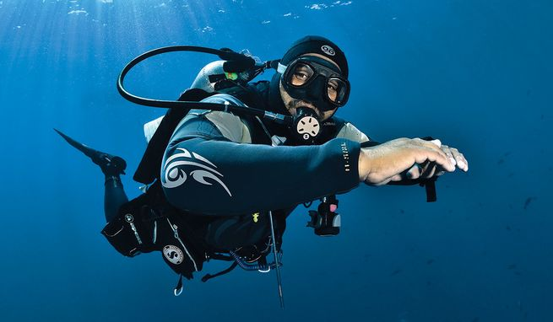
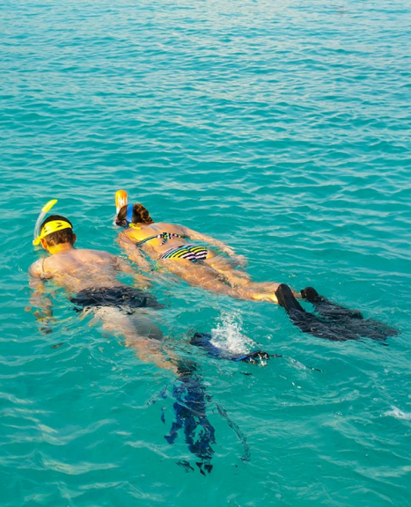
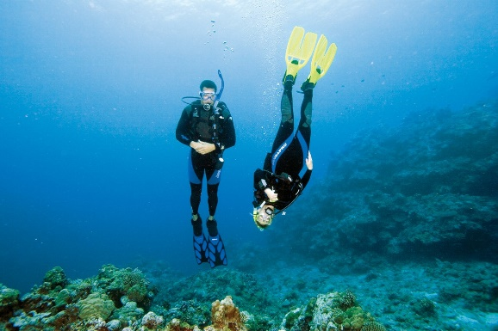

Slide 6
Take Action Workshop Be a Buoyancy Expert
What three steps can you take in the next six months to improve your buoyancy?

Slide 7
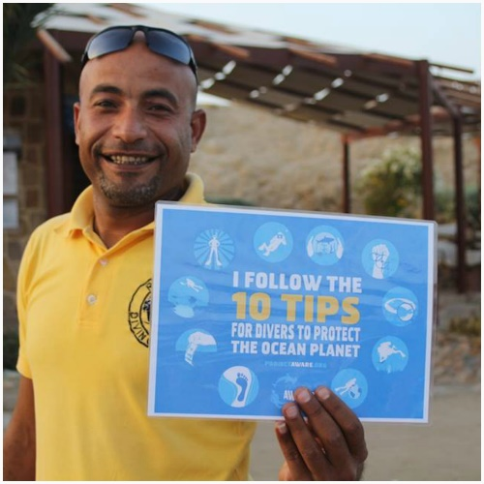
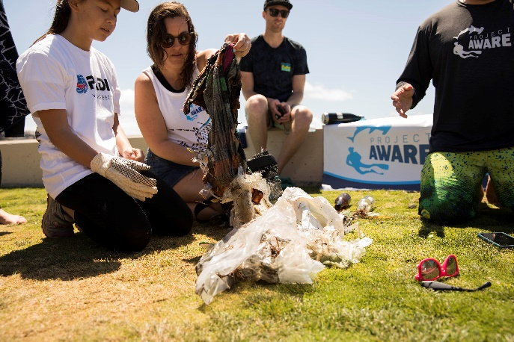
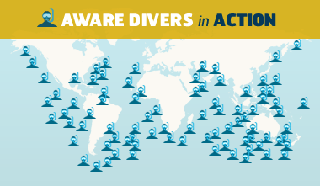
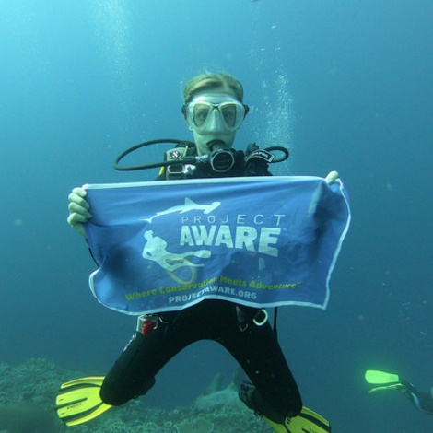
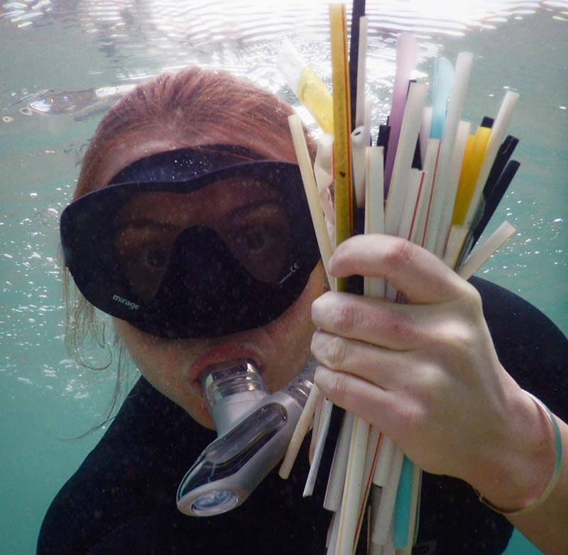
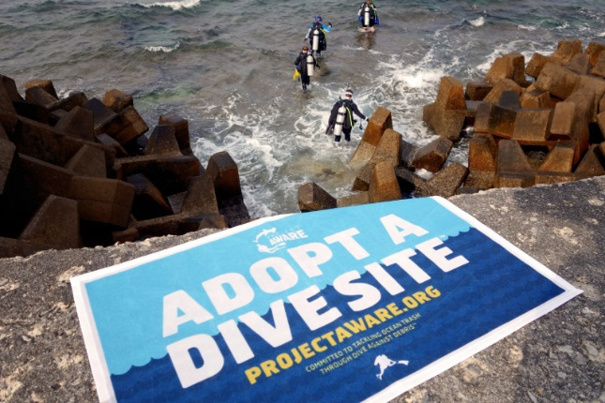

Slide 8
Take Action Workshop Be a Role Model
What three things can you do to become a better role model for the planet, fins on and fins off?

Slide 9
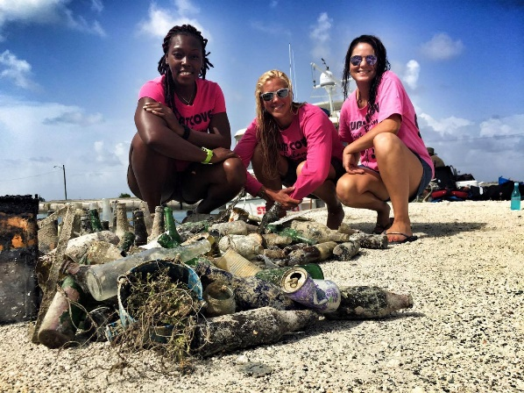
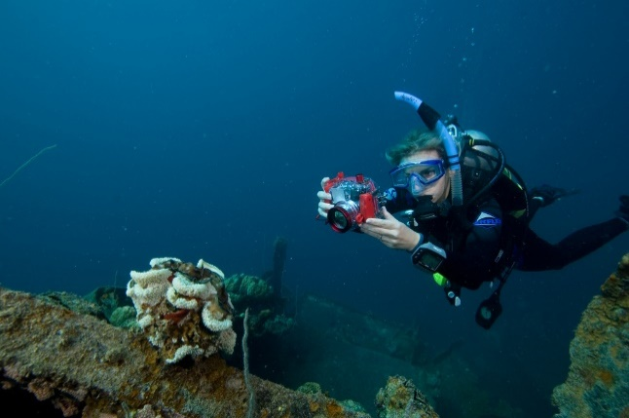
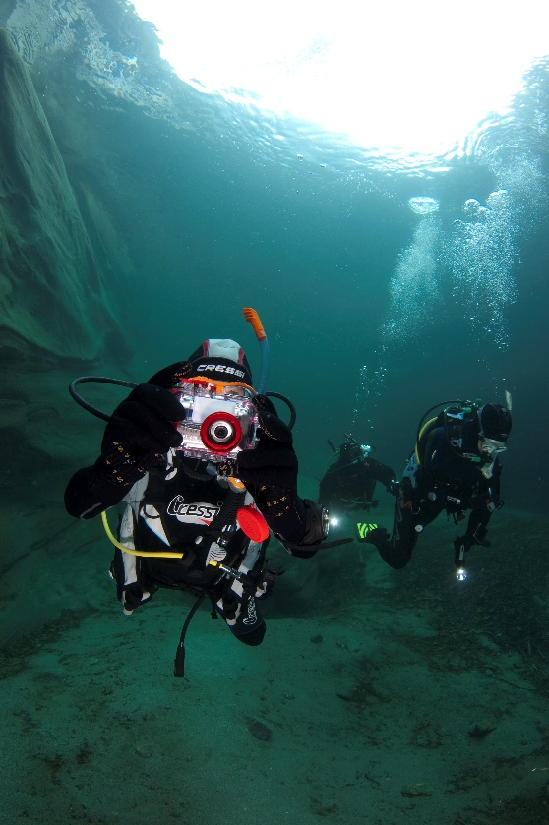
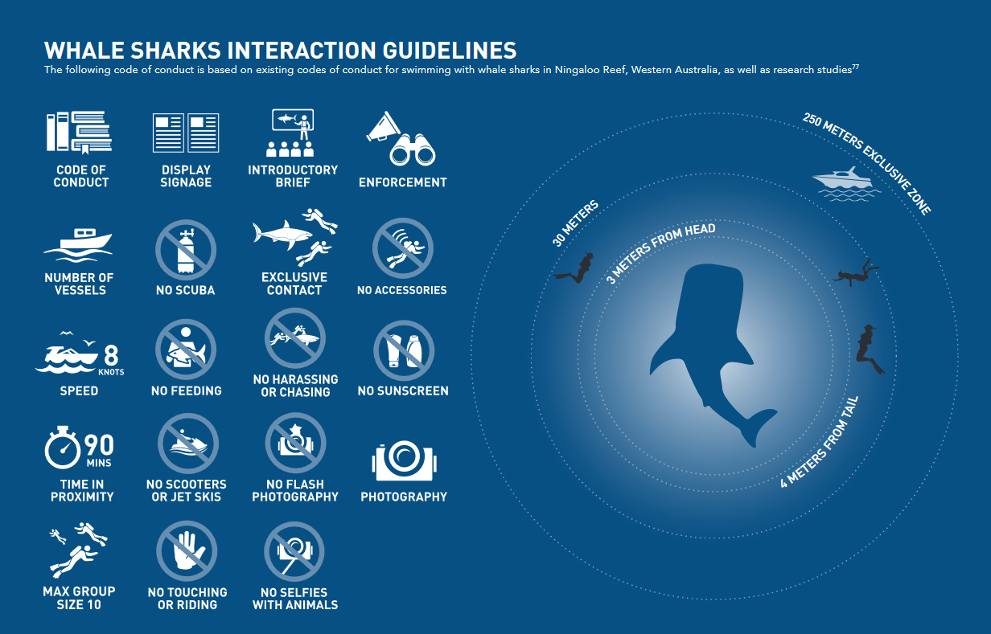

Slide 10
Take Action Workshop Take Only Photos – Leave Only Bubbles
How can photos be used to raise awareness on social media? Identify one environmental concern in your local area that would benefit.

Slide 11
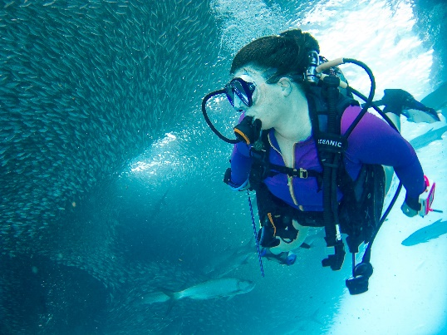
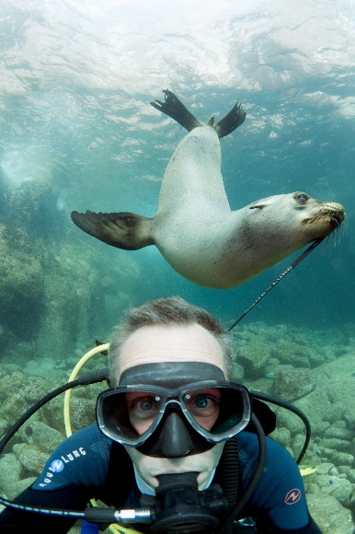
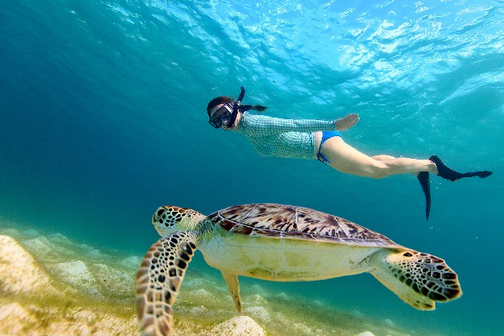
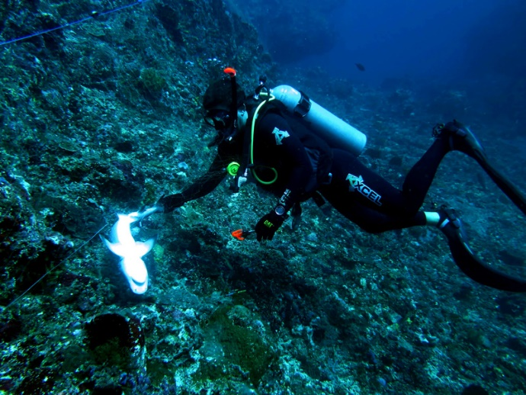
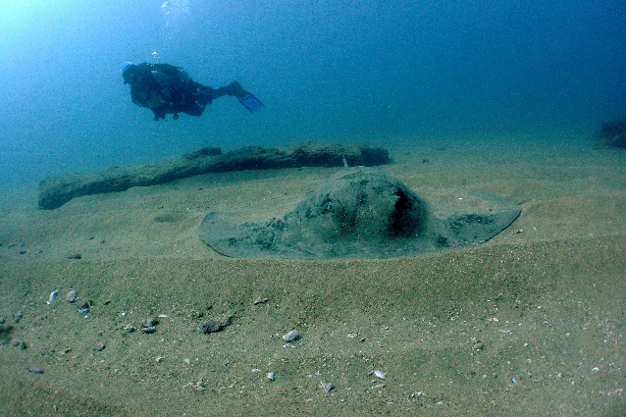

Slide 12
Take Action Workshop Protect Underwater Life
What marine animal interactions have you seen? List previous experiences in marine animal interaction both positive and negative and describe ways to encourage appropriate behaviour.

Slide 13
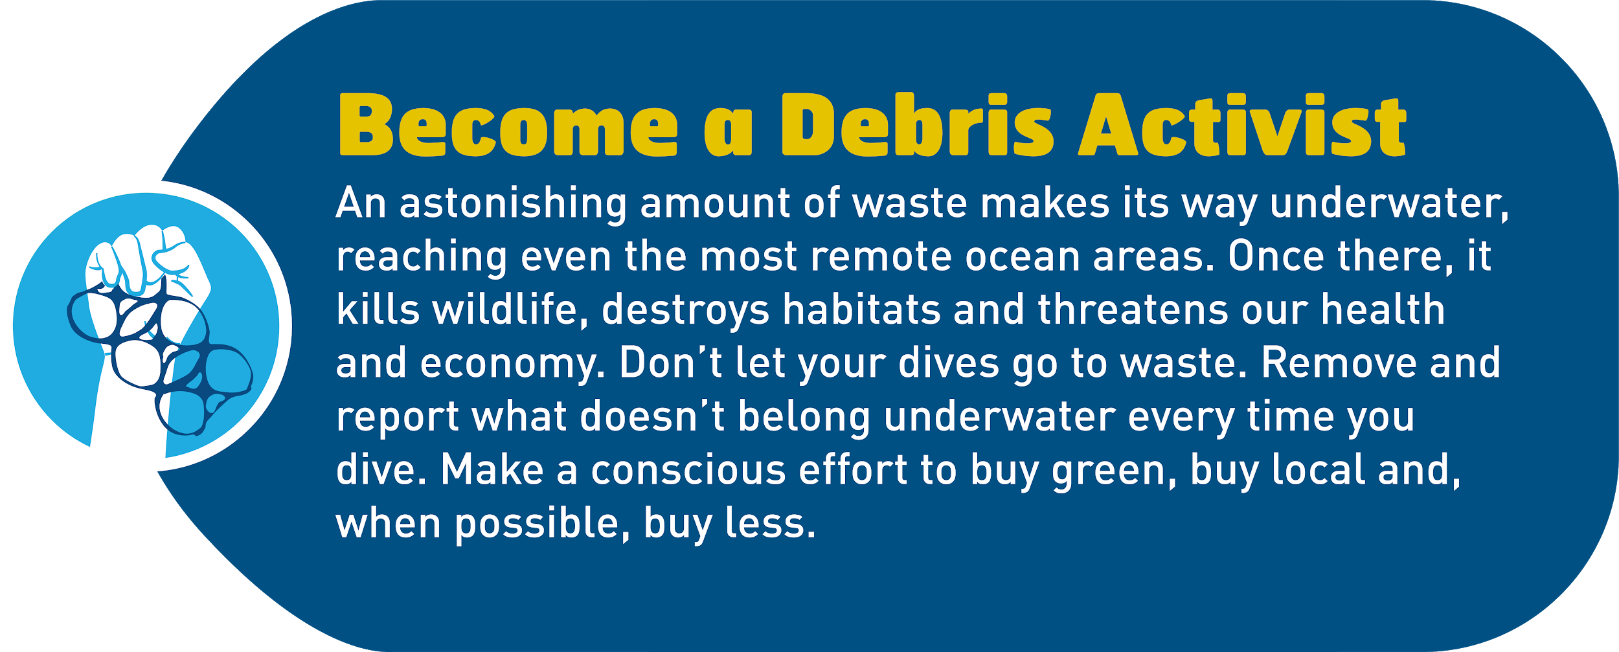
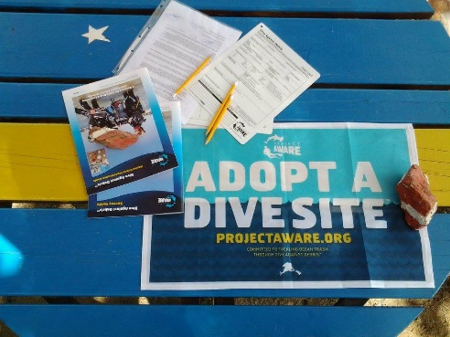
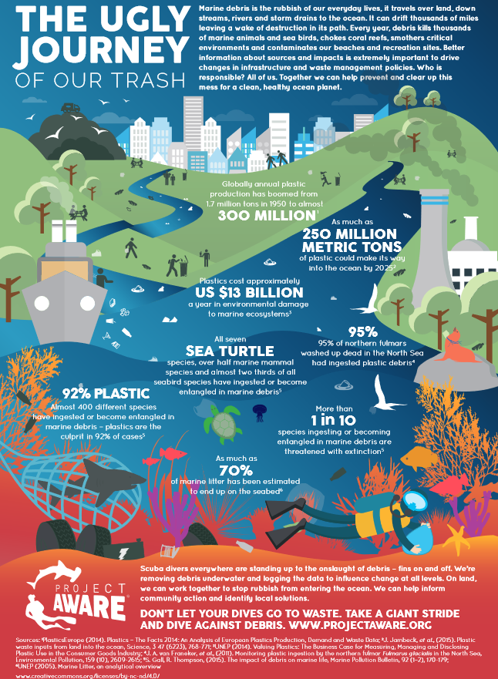
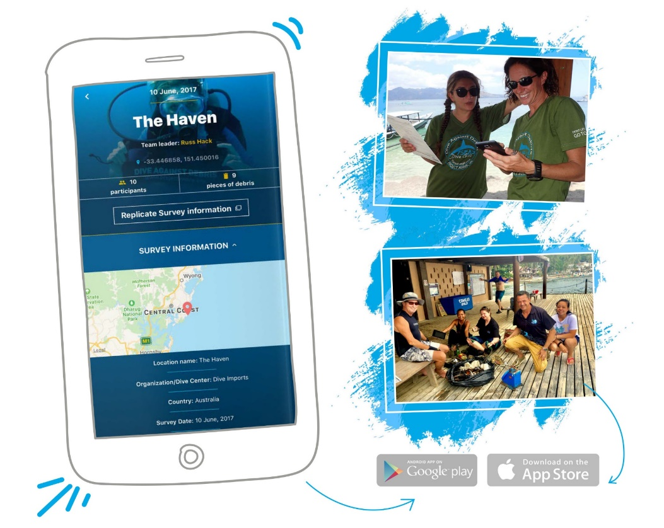

Slide 14
The Ugly Journey of Our Trash
Notes:
Can also play video from YouTube: https://youtu.be/g_HbR1Ugv08

Slide 15
Take Action Workshop Become a Debris Activist
What can you do to reduce marine debris in underwater environments?

Slide 16
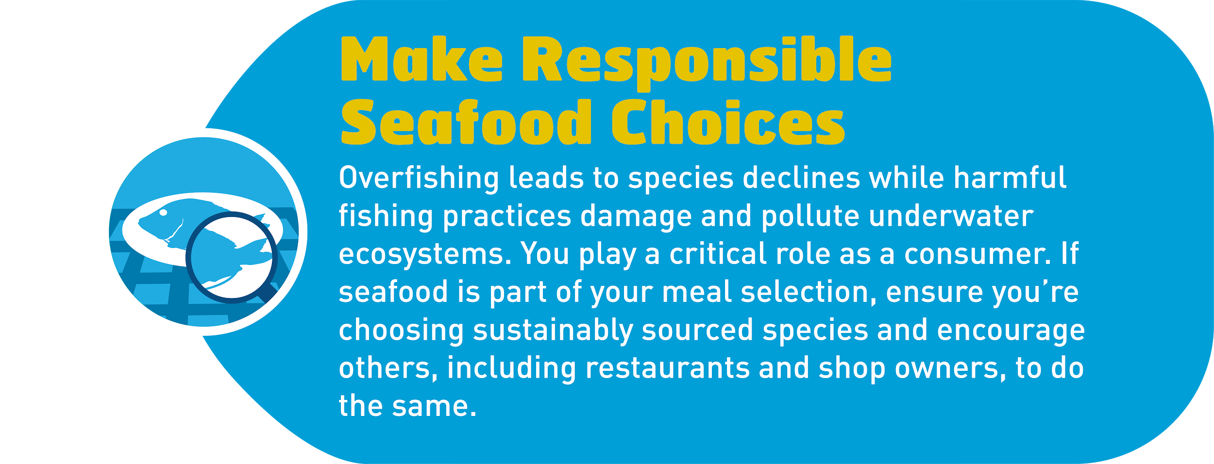
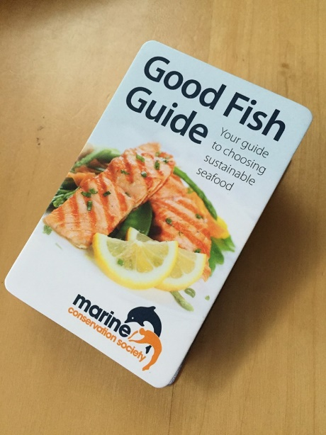
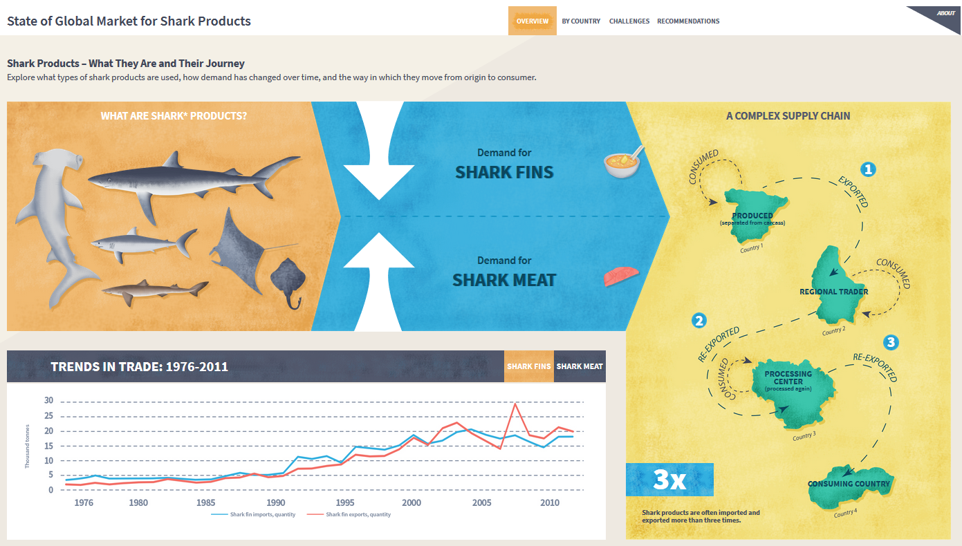
State of Global Market for Shark Products infographic

Slide 17
Take Action Workshop Make Responsible Seafood Choices
Where can you find out which fish are sustainable in your local market?

Slide 18
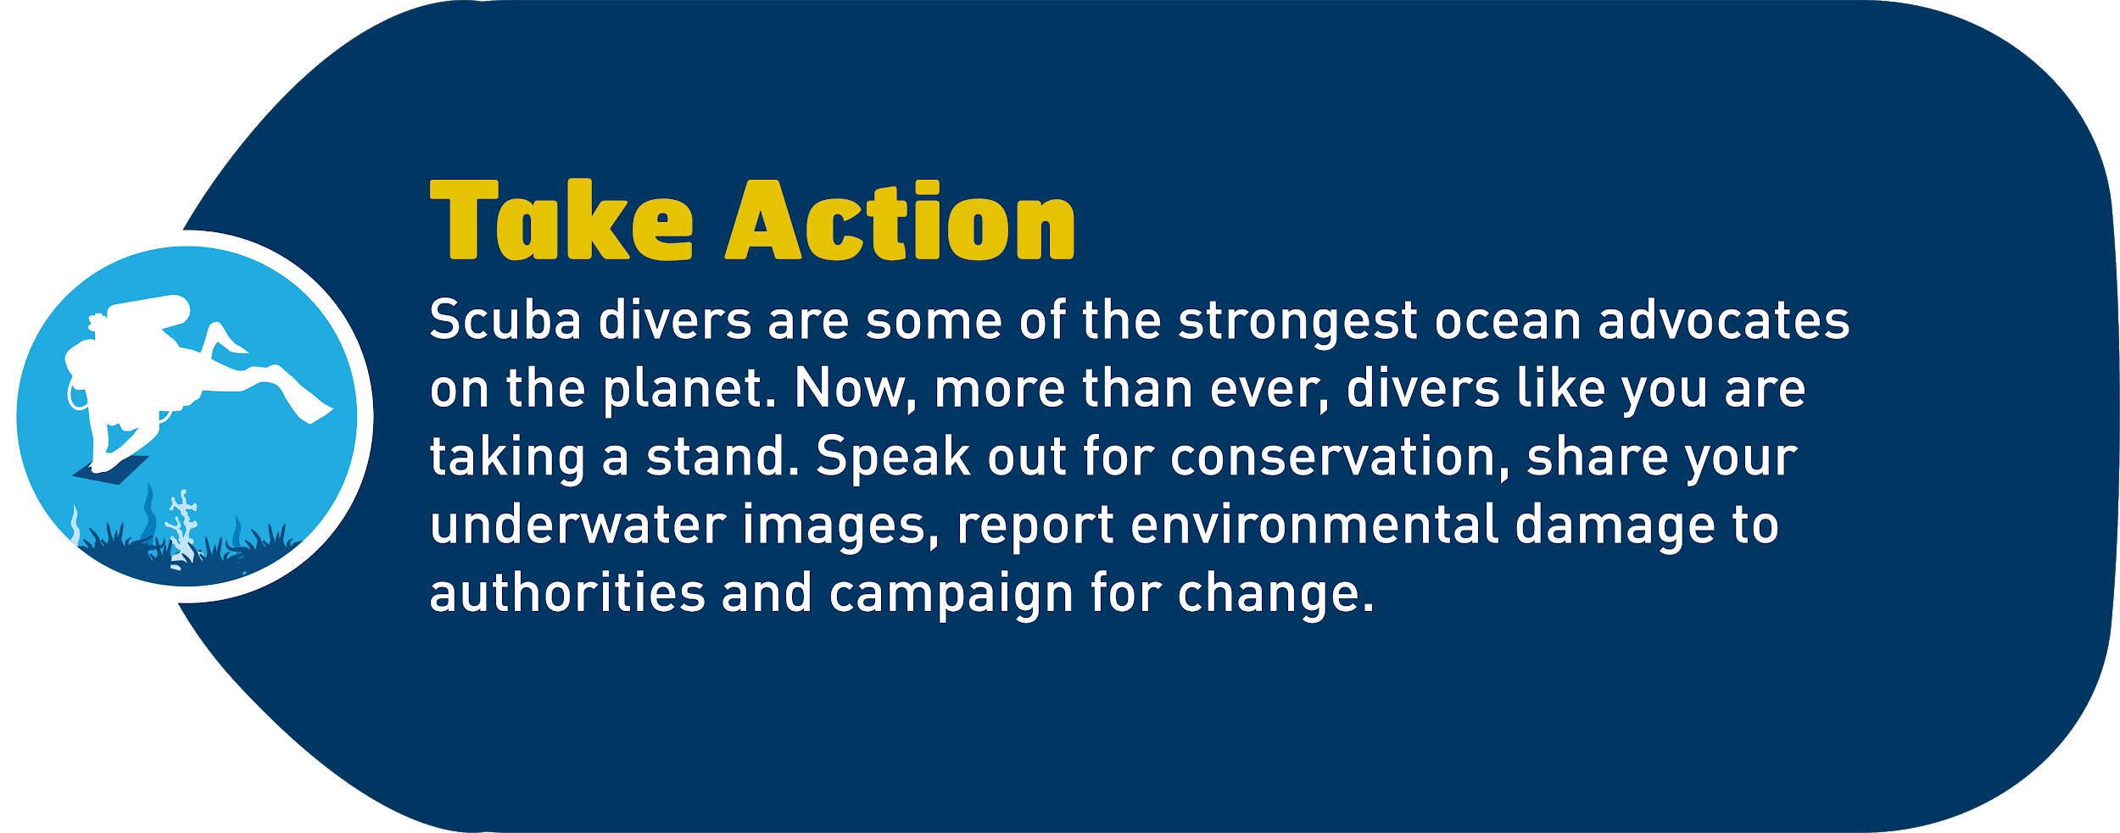
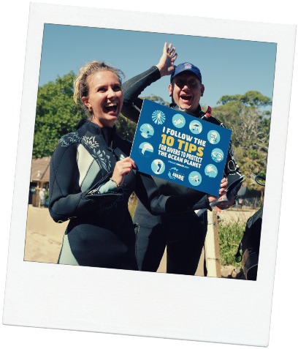
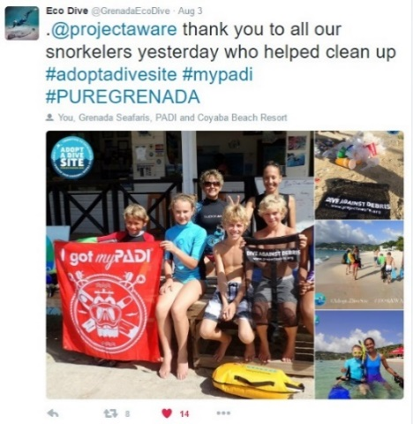
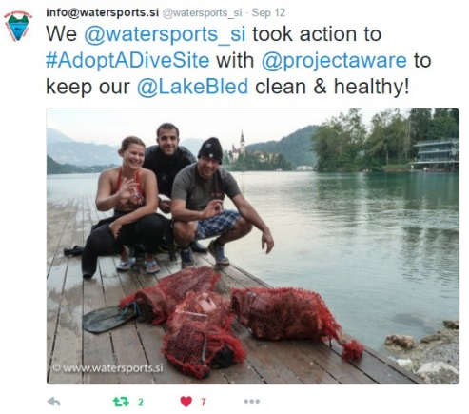
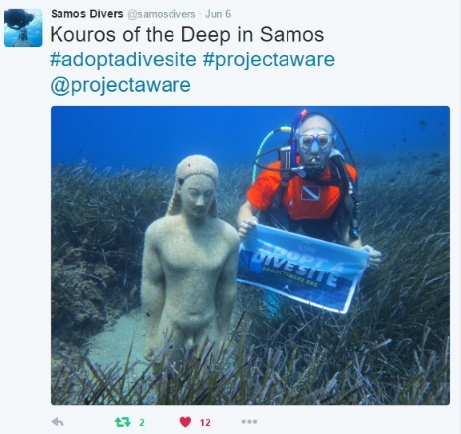
#ProjectAWARE #AWAREImpact #10Tips4Divers #DiveAgainstDebris #AdoptADiveSite

Slide 19
Take Action Workshop Take Action
What can scuba divers, freedivers and snorkelers do to take action?

Slide 20
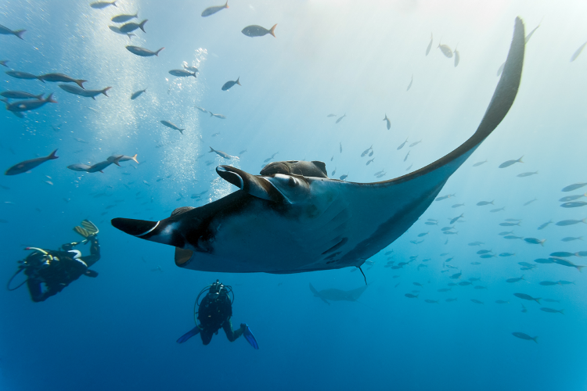
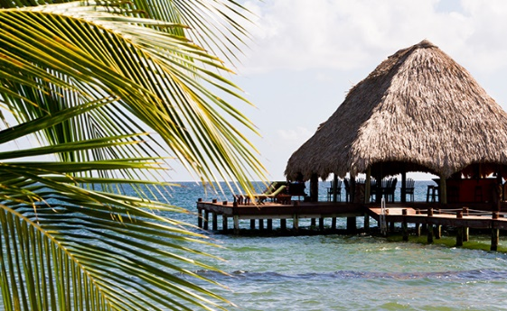
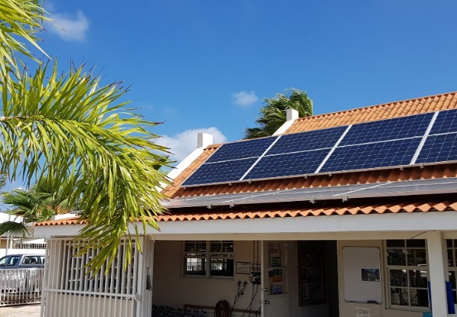
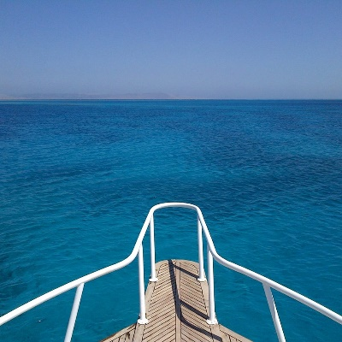
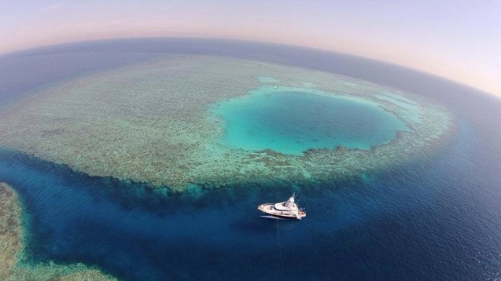
© vipdiving

Slide 21
Take Action Workshop Be an Eco-Tourist
How do you research locations for an eco-holiday?

Slide 22
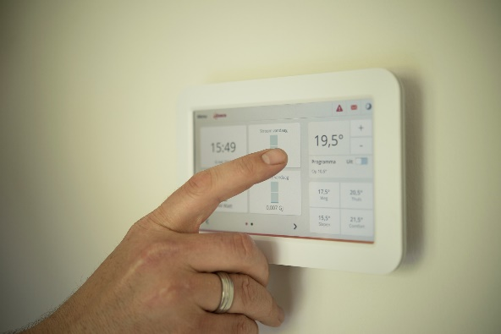
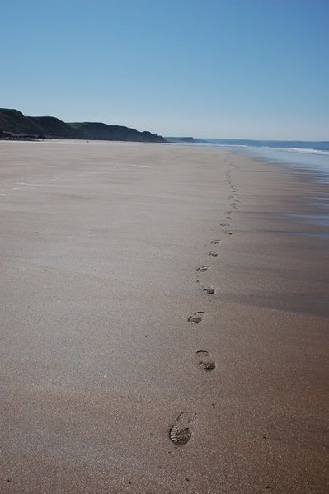
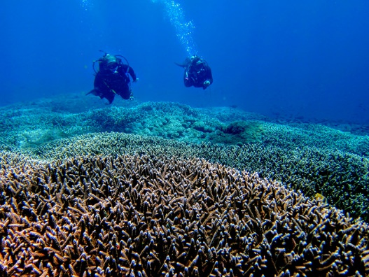
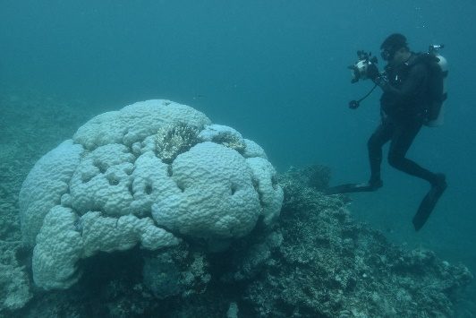

Slide 23
Take Action Workshop Shrink Your Carbon Footprint
What can you do to reduce your carbon footprint in the next six months?

Slide 24
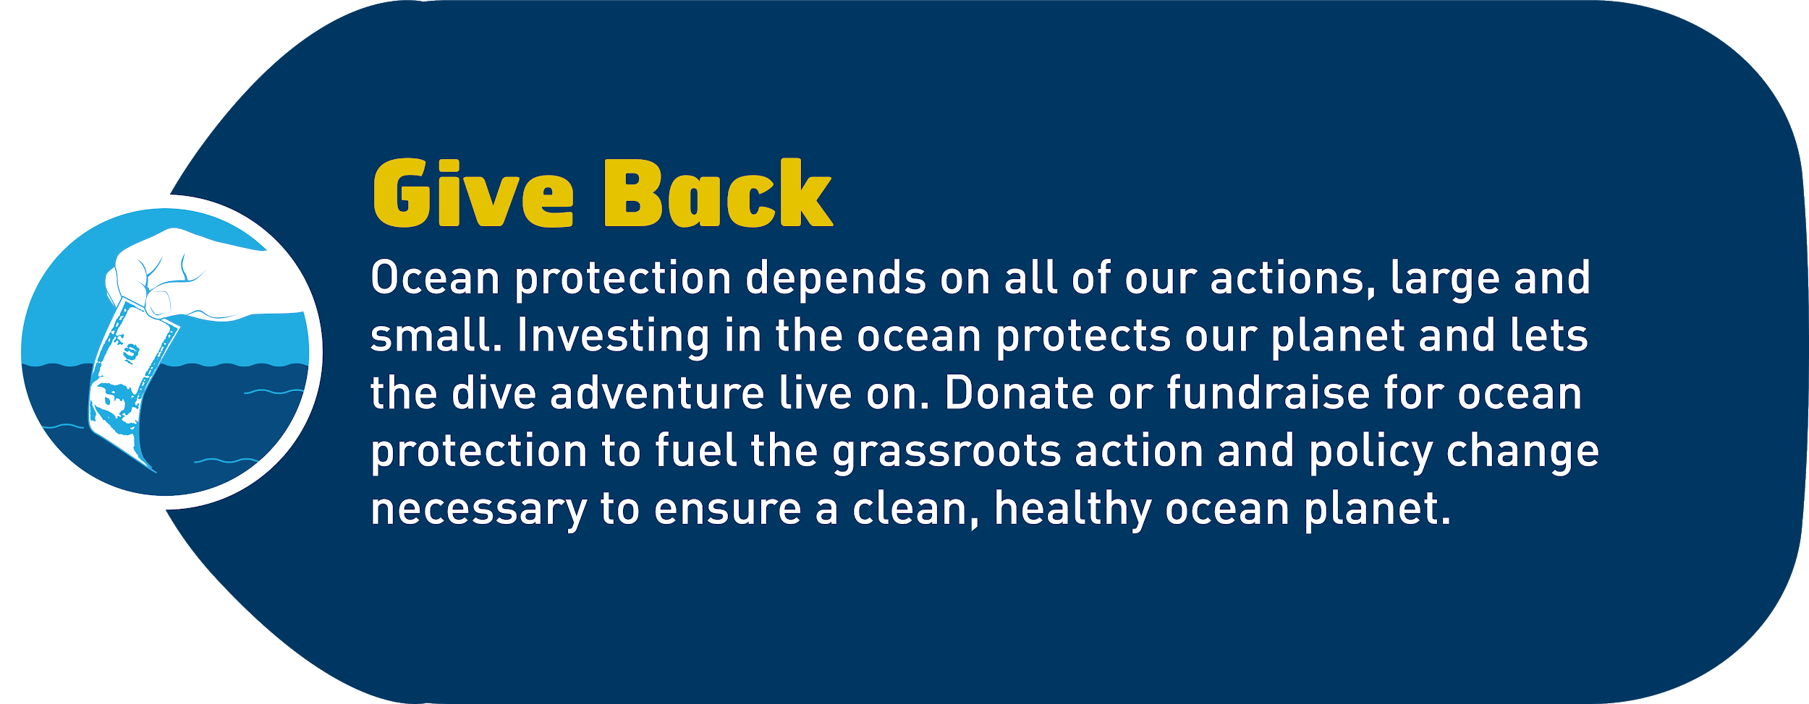
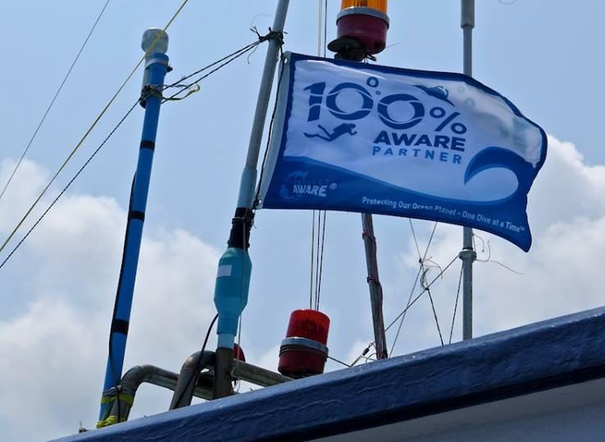

Slide 25
Take Action Workshop Give Back
How can you commit to being part of the movement for ocean conservation?

Slide 26
Project AWARE Specialty Knowledge Review
The Project AWARE Specialty Knowledge Review is your Action Plan for your Commitment for Change.
Work through the Take Action Workshop discussions and create your own Action Plan for personal commitments and actions you can take to help the environment.

Slide 27
Stay Connected…….
Stay informed and sign up for email updates from Project AWARE
Follow Project AWARE on social media
Facebook: @ProjectAWAREFoundation
Instagram: @projectaware
Twitter: @projectaware
Use the following hashtag on social media:
#ProjectAWARE

Slide 28
Project AWARE Specialty Certification
Certification: Don’t forget to choose to donate for the Project AWARE version of your PADI certification card for this Project AWARE Specialty
Other Project AWARE courses: What’s your next conservation course? Why not choose from Dive Against Debris®, AWARE Shark Conservation, Coral Reef Conservation Specialties and many more…..

Slide 29
We have covered
Introduction and Course Goals
Project AWARE and its Mission
10 Tips for Divers: From Awareness to Action >> Take Action Workshops
Knowledge Review
Stay Connected
Certification

