Slide 1
Project AWARE® AWARE Coral Reef Conservation Specialty Course Lesson Guides

Slide 2
We’ll look at. . .
Project AWARE
Importance of Coral Reefs
Understanding Coral
Complex Nature of Life on Coral Reefs
Coral Reefs in Peril
Protect the Living Reef
CRC - 02

Slide 3
Project AWARE
What is the Project AWARE Foundation?
A registered, nonprofit organization that involves divers and water enthusiasts in projects and activities to conserve underwater environments
Grown to include organizations in the United Kingdom, Australia, Switzerland and Japan
Supported through action and donations from Project AWARE Patrons
Visit projectaware.org
CRC - 03

Slide 4
Project AWARE
Why are divers and snorkelers natural ambassadors for aquatic environments?
See both short and long-term changes
Support conservation programs and initiatives such as:
Volunteer monitoring
Underwater and beach cleanups
Marine parks and protected areas
Legislative actions to support sustainable fisheries and protect endangered habitats and species
CRC - 04

Slide 5
Project AWARE
What is Project AWARE’s purpose and mission?
Conserving underwater environments through education, advocacy and action
Partnering with divers and water enthusiasts to protect aquatic environments around the world
Involving divers in environmental projects, activities and campaigns working toward global conservation solutions
CRC - 05

Slide 6
Project AWARE
What steps is Project AWARE taking in partnership with PADI to protect the aquatic world?
Emphasizing environmentally sound approaches to dive practices including:
Mooring buoy use
Responsible boating practices
Buoyancy control
Proper underwater photography techniques
Responsible wreck diving guidelines
Dive training programs
CRC - 06

Slide 7
Project AWARE
Protecting the aquatic world…
Implementing initiatives to expand participation in underwater cleanups, coral reef monitoring, shark identification and sightings, education and advocacy
Empowering children to get involved through the AWARE Kids program
Increasing implementation of sustainable business practices and expanding financial support for projects and research
CRC - 07

Slide 8
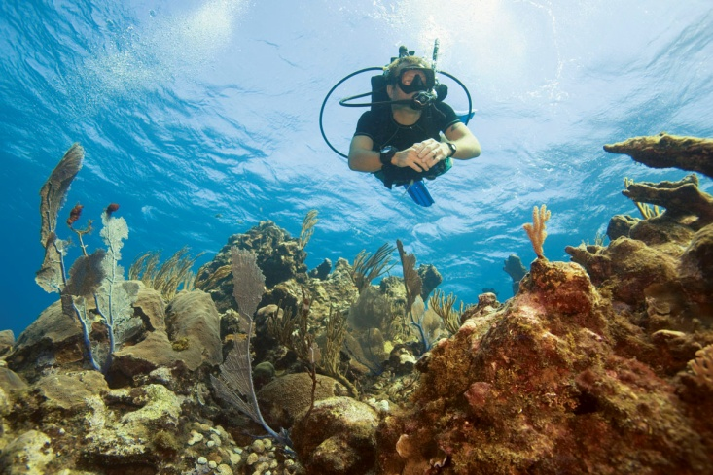
Importance of Coral Reefs
Why are coral reef ecosystems important and how do they maintain biological diversity?
Coral reefs are:
Less than 0.1% of the sea bottom
Nursery grounds to 25% of known marine species
Home to nearly 33% of all known fish species
CRC - 08

Slide 9
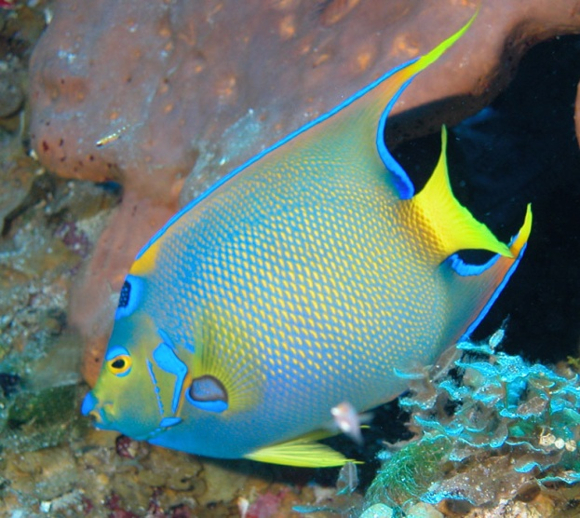
Importance of Coral Reefs
Important ecosystems. . .
Atlantic – contains about 8% of reefs with 70 coral species and 500 fish species
Indo-Pacific – contains about 92% of reefs with 700 coral species and 4000 fish species
80,000 species identified on reefs, but may contain more than 9 million
CRC - 09

Slide 10
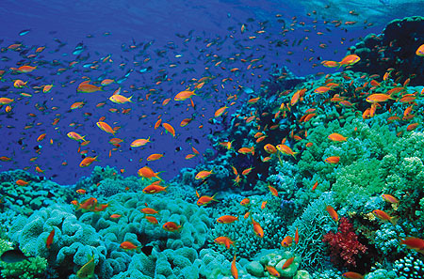
Importance of Coral Reefs
How do reefs maintain biological diversity?
Greater numbers ensure redundancy
Allows ecosystem to adapt to change
Species are like rivets holding an airplane together – lose enough and it comes crashing down
CRC - 10

Slide 11
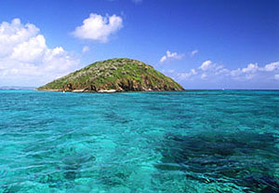
Importance of Coral Reefs
What benefits do coral reefs provide to islands, coastal areas and tourism?
Act as barriers for 1/6 of coastlines
Absorb wave energy to protect low lying islands
CRC - 11

Slide 12
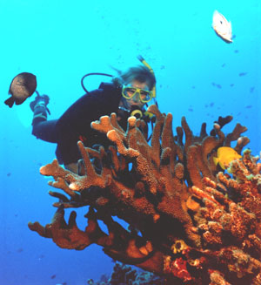
Importance of Coral Reefs
Benefits to tourism. . .
World’s largest industry – sustains 10% of all jobs
Potential revenue about 25 times larger than fisheries
Square kilometre can generate $3 million US in tourism
Plus, $100,000-600,000 US in goods and services
Must be well planned and managed
CRC - 12

Slide 13
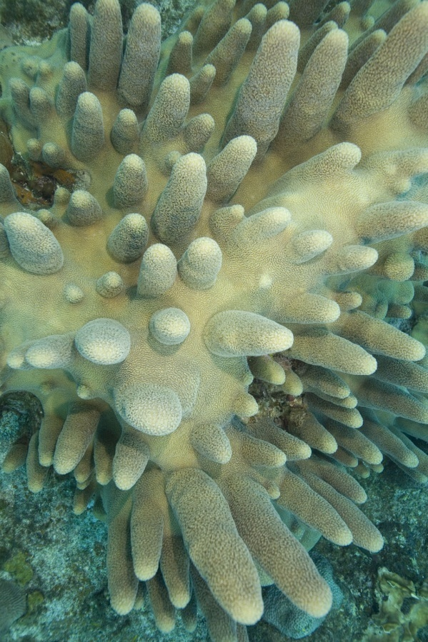
Importance of Coral Reefs
How can corals benefit human health?
Produce biomedical compounds
Used for bone replacement
More to be discovered
CRC - 13

Slide 14
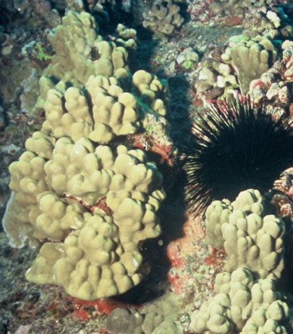
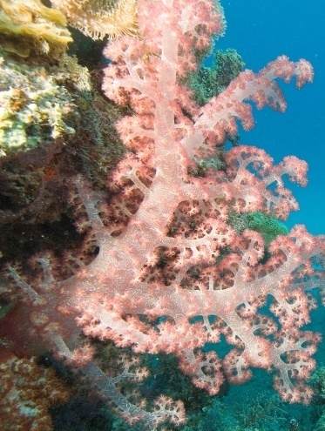
Understanding Coral
What is coral and why is it difficult to classify?
Appears to be animal, plant and mineral
Corals are animals with:
Symbiotic relationship with algae called zooxanthellae
Limestone houses
Some corals are soft, flexible and don’t contain zooxanthellae
CRC - 14

Slide 15
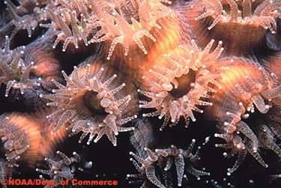
Understanding Coral
What is coral. . .
Most coral is colonial – single polyps join together
Polyps have two skin layers with jelly-like mass in between
Tentacles around mouth capture plankton
CRC - 15

Slide 16
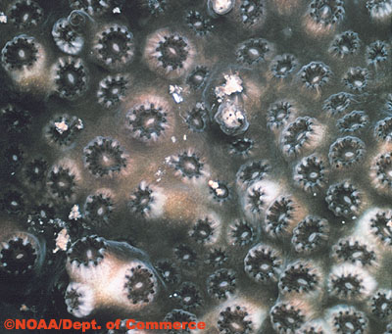
Understanding Coral
What are zooxanthellae and what role do they play in coral physiology?
Single-cell algae living within the coral
Beneficial relationship helps reef building corals grow
Zooxanthellae use coral waste and photosynthesis to produce carbohydrates for coral nutrition
Coral provides food and safe home
CRC - 16

Slide 17
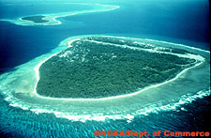
Understanding Coral
How do coral reefs form?
Reefs are the oldest, most productive, diverse ecosystems in the sea, but modern reefs are less than 9,000 years old
Two popular formation theories:
Geological subsidence – fringing reefs lead to barrier reefs which lead to atolls
Changing sea level and erosion
CRC - 17

Slide 18
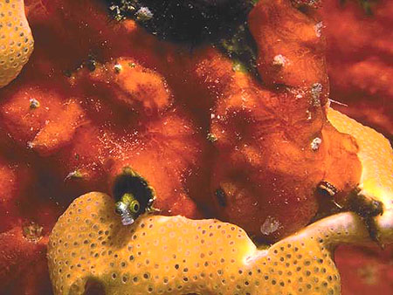
Understanding Coral
What other calcifying organisms help maintain reef integrity?
Organisms help cement reef together and create tunnels and grottos:
Coralline algae
Encrusting fire coral
Soft corals
Bryozoans
Forams
CRC - 18

Slide 19
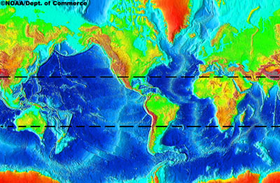
Complex Nature of Life on the Coral Reef
What limits coral reef distribution and how do coral reefs exist in nutrient deficient waters?
Temperature
Depth
Salinity
Water clarity
Waves
Bottom type
CRC - 19

Slide 20
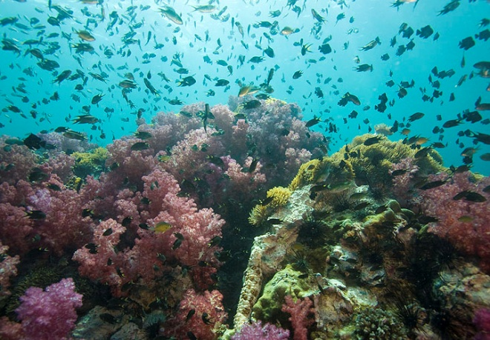
Complex Nature of Life on the Coral Reef
Reefs in nutrient deficient waters. . .
Darwin’s Paradox
how do low nutrient oceans produce the most productive ecosystems on earth?
Highly efficient nutrient recycling system
Reef produces massive algae growth
Grazers eat alga
Excess nutrients pass through grazers back to reef
CRC - 20

Slide 21
While a coral reef’s biomass production is extremely high, the net is incredibly small.
The amount of biomass that can be taken on a sustainable basis is very limited.
CRC - 21

Slide 22
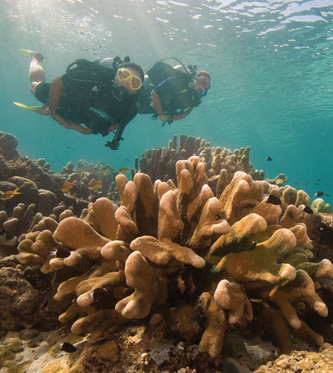
Complex Nature of Life on the Coral Reef
How do corals reproduce and grow?
Asexual reproduction – cloning to increase colony size
Sexual reproduction – free swimming larvae create new colonies
Young, small colonies grow faster
Branching corals grow much faster than boulder corals
CRC - 22

Slide 23
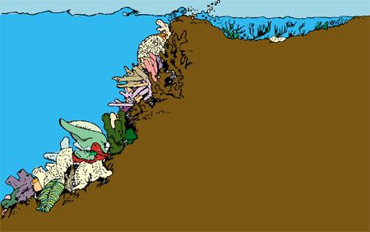
Complex Nature of Life on the Coral Reef
What is zonation?
Zones are subhabitats within a reef
Areas defined by complex associations between creatures and the environment
Zones help better understand ecosystem dynamics and changes over time
CRC - 23

Slide 24
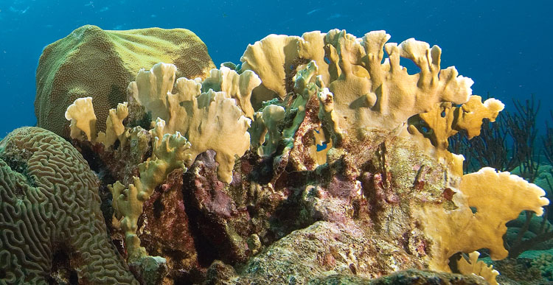
Complex Nature of Life on the Coral Reef
How do corals battle for space with each other and compete with other reef residents?
Defensive and aggressive mechanisms prevent monopolization and preserve diversity
Faster growing rates are balanced by stinging tentacles and toxins
CRC - 24

Slide 25
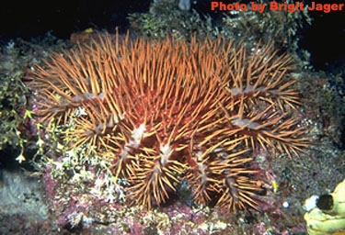
Complex Nature of Life on the Coral Reef
Competition. . .
Imbalance may result in predator population explosions and destruction
Example – Crown-of-thorns sea star
CRC - 25

Slide 26
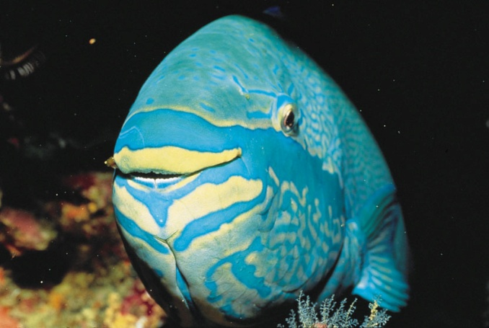
Complex Nature of Life on the Coral Reef
Why is grazing so important to reef ecology and how are reef fish classified by what they eat?
Grazing enhances primary productivity and recycles nutrients
Herbivores are 10% of reef fish species, but 50% of population
CRC - 26

Slide 27
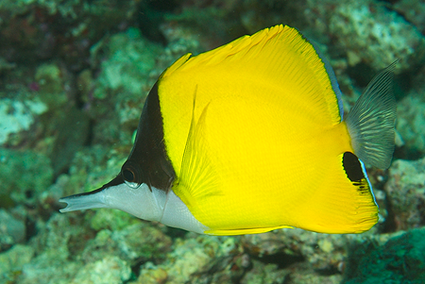
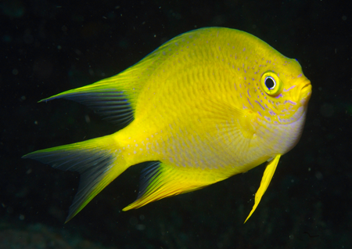
Complex Nature of Life on the Coral Reef
Reef fish classification by diet. . .
Feeding preference explains body size and shape
Most fish are opportunistic
Herbivores – eat plants
Usually found shallower
Cows of the reef
CRC - 27

Slide 28
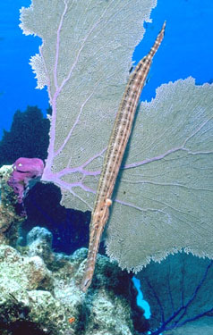
Complex Nature of Life on the Coral Reef
Reef fish classification by diet. . .
Carnivores – eat other creatures
50-70% of reef fish
Hunting strategies
Pursuit
Stalking
Ambush
To learn more, take the AWARE – Fish
Identification Specialty course
CRC - 28

Slide 29
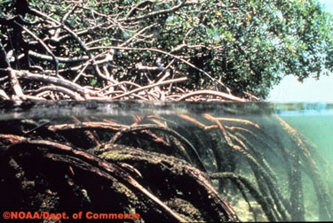
Complex Nature of Life on the Coral Reef
What two related ecosystems are important to coral reef ecology?
Mangroves – tropical inshore forests dominated by trees and shrubs that grow in salt water
Trap and break down organic matter
Filter pollutants and sediments
Habitat for juveniles and invertebrates
CRC - 29

Slide 30
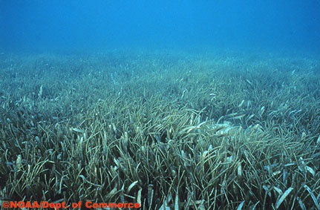
Complex Nature of Life on the Coral Reef
Related ecosystems. . .
Seagrass Beds
Facilitate sediment settlement
Recycle nutrients
CRC - 30

Slide 31
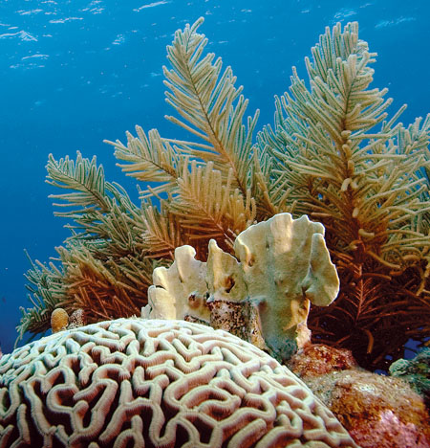
Coral Reefs in Peril
What is the worldwide status of coral reefs and estimated loss?
In 1998, estimated 58% were at risk of destruction
Reefs could be gone within 30 - 50 years
In 2000, 11% degraded beyond recovery
In 2004, 20% dead
CRC - 31

Slide 32
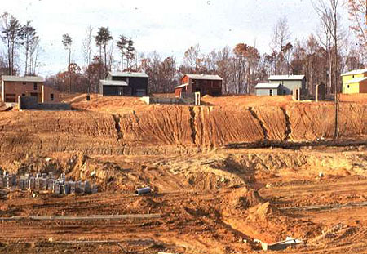
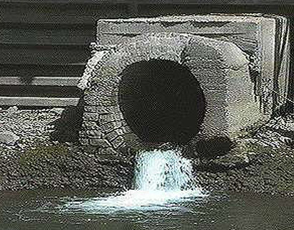
Coral Reefs in Peril
What land-based activities are detrimental to coral reefs?
Poor land use that causes erosion
Agriculture and sewage discharge that causes nutrient loading
Nonpoint source pollution carrying dissolved substances
CRC - 32

Slide 33
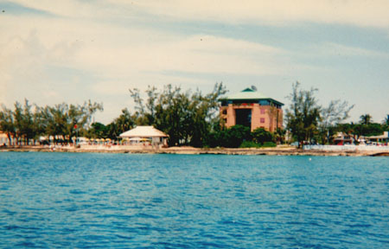
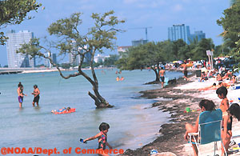
Coral Reefs in Peril
Detrimental land-based activities . . .
Coastal development and habitat destruction
Tourism that damages coastal habitats and dumps wastes
CRC - 33

Slide 34
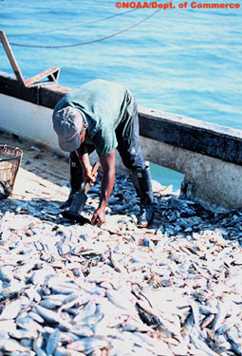
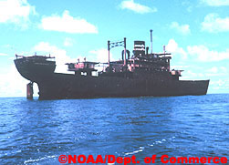
Coral Reefs in Peril
What ocean-based activities are detrimental to coral reefs?
Overfishing
Destructive fishing practices
Collision and anchor damage
Coral mining
Coral collecting
CRC - 34

Slide 35
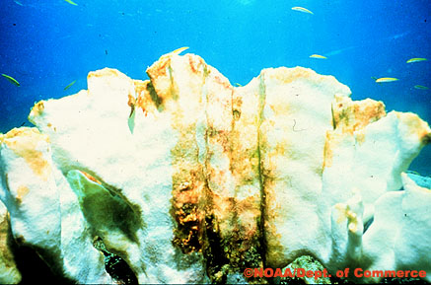
Coral Reefs in Peril
What detrimental effect does climate change have on coral reefs?
Global warming leads to:
Higher water temperature
Extreme and unpredictable weather
Rising sea levels
Ocean acidification
Ozone depletion may allow more UV radiation to reach the reef leading to genetic damage
CRC - 35

Slide 36
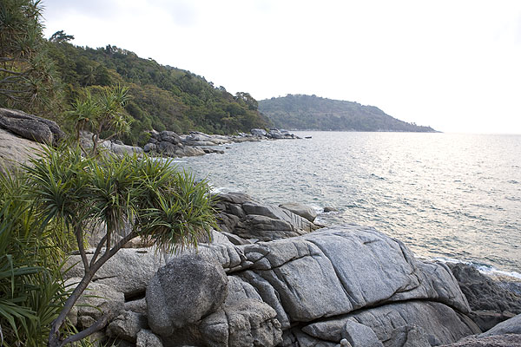
Protect the Living Reef
Why are integrated coastal zone management and sustainable development so important to coral reef conservation?
Healthy systems depend on healthy parts
Successful reef management must include associated watershed and nearshore communities
CRC - 36

Slide 37
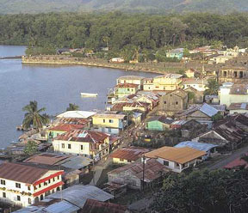
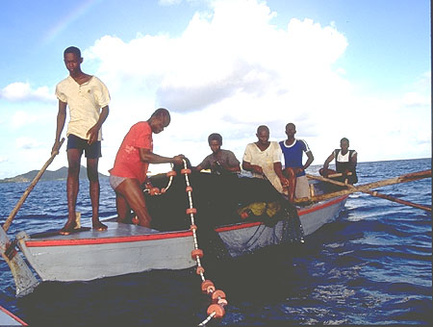
Protect the Living Reef
Coastal zone management . . .
Success includes:
Involving local people and considering local culture, historical use and political realities
Providing short and long-term incentives
CRC - 37

Slide 38
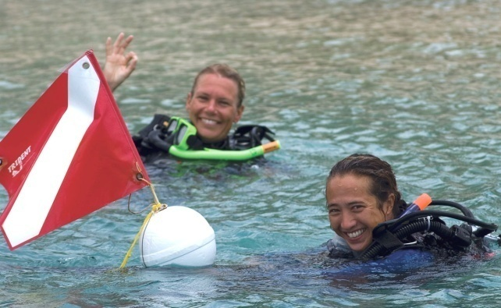
Protect the Living Reef
Sustainable development. . .
Managing resources for future generations provides benefits:
Ecotourism
Improved waste treatment – minimal or no-discharge
Creating and expanding parks, reserves and sanctuaries to protect multiple ecosystems
CRC - 38

Slide 39
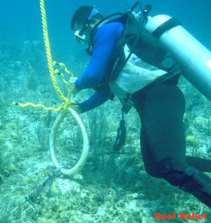
Protect the Living Reef
How can you promote coral reef conservation?
Avoid purchasing reef souvenirs
Choose conservation-minded resorts
Maintain and operate a boat properly
Choose dive operators that use mooring buoys
Select seafood wisely
CRC - 39

Slide 40
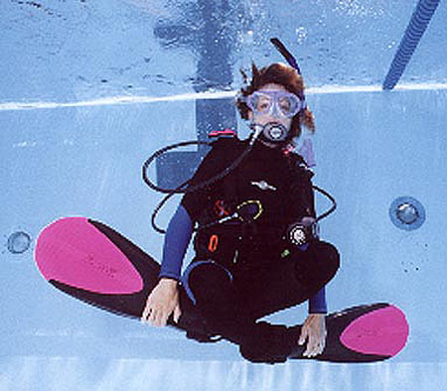
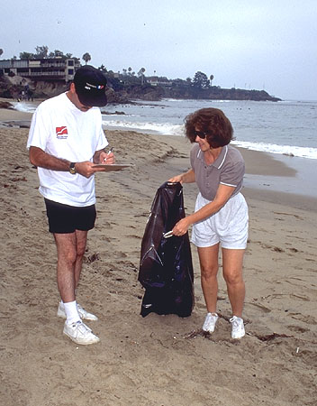
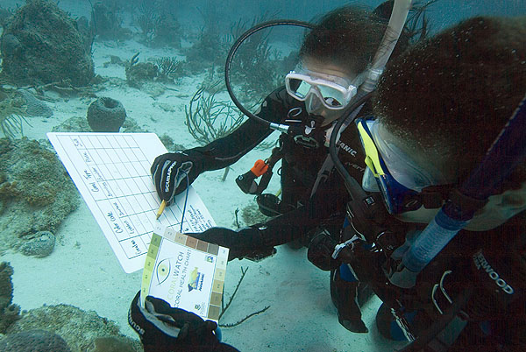
Protect the Living Reef
Promote coral reef conservation . . .
Don’t buy product made from clear-cut tropical forests
Further your education
Get involved in conservation activities such as CoralWatch
CRC - 40

Slide 41
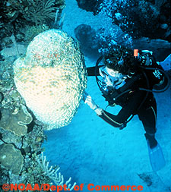
Protect the Living Reef
What are responsible coral reef dive practices?
Don’t touch
Passively observe
Practice buoyancy control
Streamline and secure equipment
Avoid swimming too close to reef
CRC - 41

Slide 42
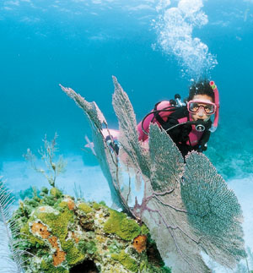
Protect the Living Reef
Responsible dive practices. . .
Approach reef carefully
Avoid kicking up sand
Be aware of body position
Avoid feeding reef fish
Don’t collect souvenirs
Use care when taking photos
CRC - 42

Slide 43
Protect the Living Reef
Click to play snorkeling video
CRC - 43

Slide 44
Protect the Living Reef
Click to play diving video
CRC - 44

Slide 45
We’ve discussed. . .
Project AWARE
Importance of Coral Reefs
Understanding Coral
Complex Nature of Life on Coral Reefs
Coral Reefs in Peril
Protect the Living Reef
CRC - 45

